Slide 1
Call Center Dashboard Design & Other Module change

Slide 2
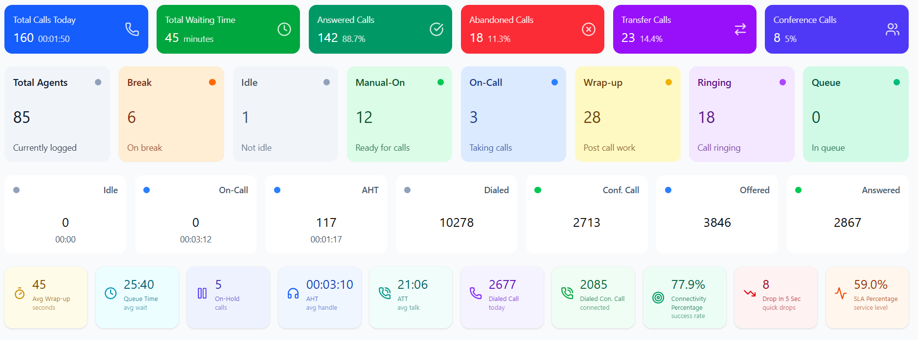

Slide 3
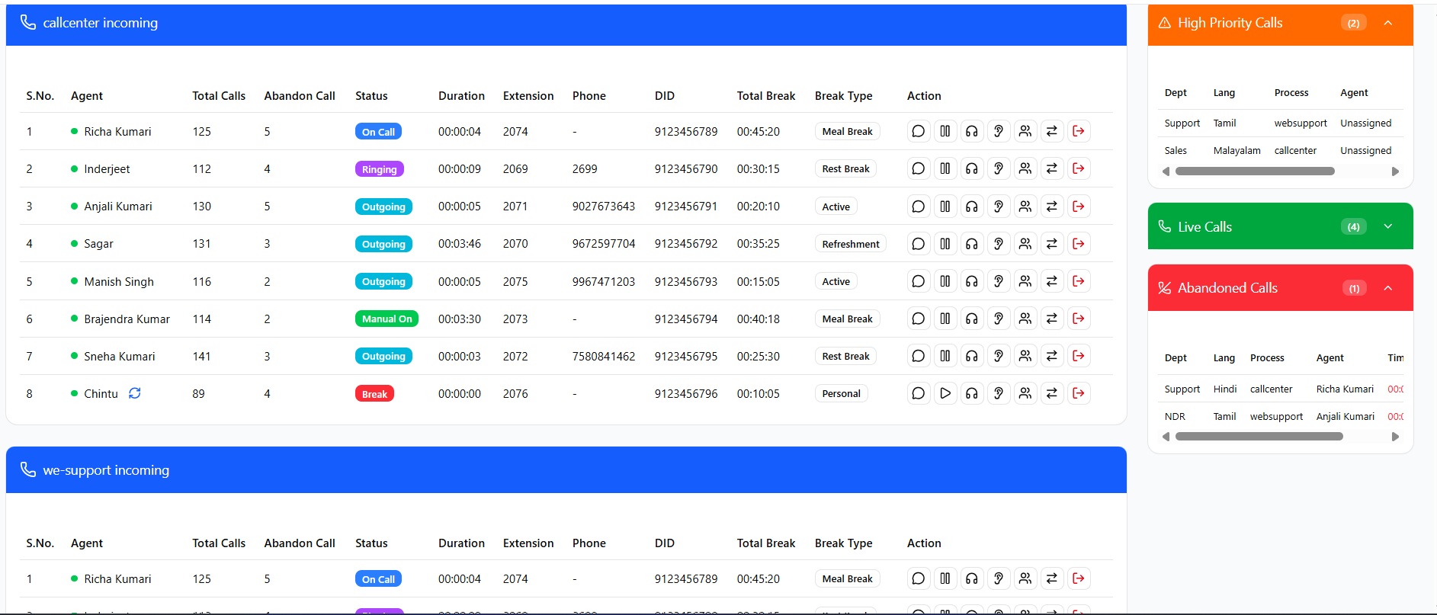

Slide 4
📊 Suggested Report Types for Better Analytics
1. Agent Performance Report
Metrics per agent:
Total Calls Handled
Answered vs Abandoned Calls
Average Call Duration (Talk + Wrap-up)
Break Time (with type: Meal, Rest, Personal, etc.)
Queue Handling Efficiency (how many calls picked from queue)
Use Case: Helps supervisors track productivity and identify top/bottom performers.
2. Call Flow Report
Metrics:
Offered Calls vs Answered Calls
Abandoned Calls (with wait time before drop)
Transfer Calls (who initiated, to whom, success/failure)
Conference Calls
Outbound vs Inbound split
Use Case: Understand how calls are being managed, identify choke points in routing.

Slide 5
3. Queue & Waiting Time Report
Breakdown:
Queue Time (avg, max, min)
Department-wise waiting load (Sales, Support, NDR, etc.)
Language-wise distribution (Hindi, English, Tamil, Telugu, etc.)
Calls dropped while waiting
Use Case: Helps optimize IVR routing and staffing per department/language. 4. SLA & Service Quality Report
KPIs:
Service Level % (calls answered within SLA target, e.g., 30 sec)
Average Handling Time (AHT) vs Target
Connectivity Success Rate (Connected Calls / Dialed Calls)
Quick Drops (calls disconnected in <5 seconds)
Use Case: Measure compliance with service agreements and customer satisfaction benchmarks.
5. Break & Idle Report
Metrics per agent:
Total Breaks Taken (time + type)
Idle Time vs On-Call Time ratio
Manual-On usage (agents marking ready but not taking calls)
Use Case: Ensures fair break distribution and prevents misuse of idle/manual status.

Slide 6
6. Missed Call & Callback Report
Data Points:
Missed Calls (abandoned + disconnected while in queue)
Auto-assignment logs (to longest idle agent)
Callback attempts & outcomes
Use Case: Prevents customer loss, ensures every missed call gets follow-up. 7. Department & Language Utilization Report
Breakdown:
Calls handled per department (Sales, Support, Verification, etc.)
Calls handled per language
Queue-to-answer ratio per category
Use Case: Forecast staffing requirements per department & language.
8. Real-Time Alerts Dashboard (for Supervisors)
Visual KPIs:
Live Calls
Agents on Break
Calls in Queue (highlight if >10 waiting)
Abandoned Call Spike (red alert if >10 in 5 mins)
Use Case: Live operational control, like a command center view.

Slide 7
Change Required
📌 Call Center Dashboard & DID Flow – Developer Requirements
1. DID Management & Preview
Show active DID list with preview.
Include old DID call incoming status flow for tracking past performance.
Add DID-wise report to check:
Incoming calls per DID
Call response status (answered, missed, abandoned, transferred, etc.)
2. Reporting & Columns
Add Column AB → Show who disconnected the call (Agent cut / agent disconnect).
Add Total Break Time per agent:
Tea
Lunch
Washroom
Medical
Highlight break exceeded limit in RED.(1:00:00)

Slide 8
3. Call Transfer & Conference Flow
Enable Agent Selection for call transfer and conference:
Same Department: show available agents in that department.
Cross Department: show available agents from other departments (list view).
Flow: Customer → Hold/Waiting → Agent selects transfer → System lands call to target agent.
4. Customer Call Handling Rules
Max Call Limit Rule:
One agent can handle a maximum of 4 calls from the same customer.
After 5 calls → Permission required for the agent.
Further calls must be routed from a different DID.
5. Additional Points
Show total waiting time and queue flow per DID.
Track call transfer history (Agent → Target Agent/Department).
Flash/notification popup for missed calls.
Dashboard filters by: DID, Agent, Department, Date Range.

Slide 9
6 if any addition Deepak can addon the points more.

