Slide 1

Welcome to company profile
Since 1997…

Slide 2
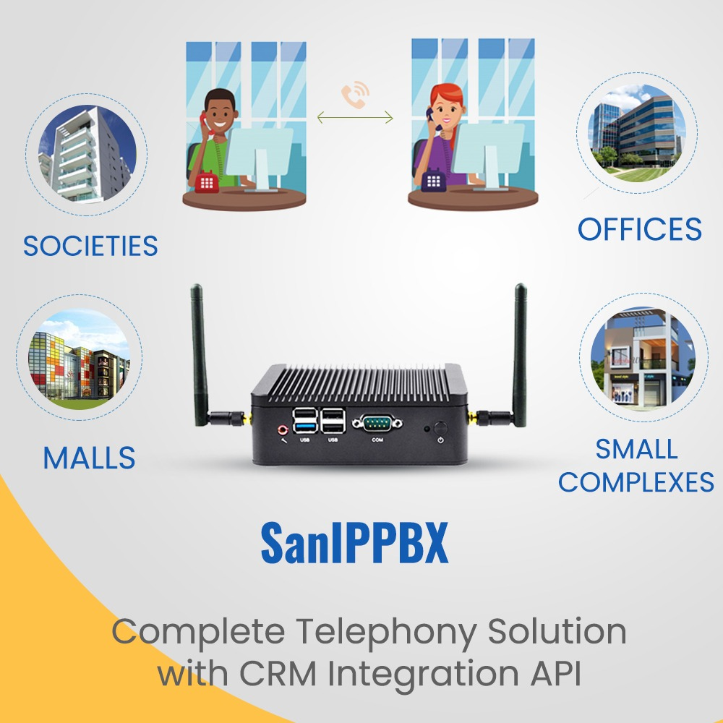
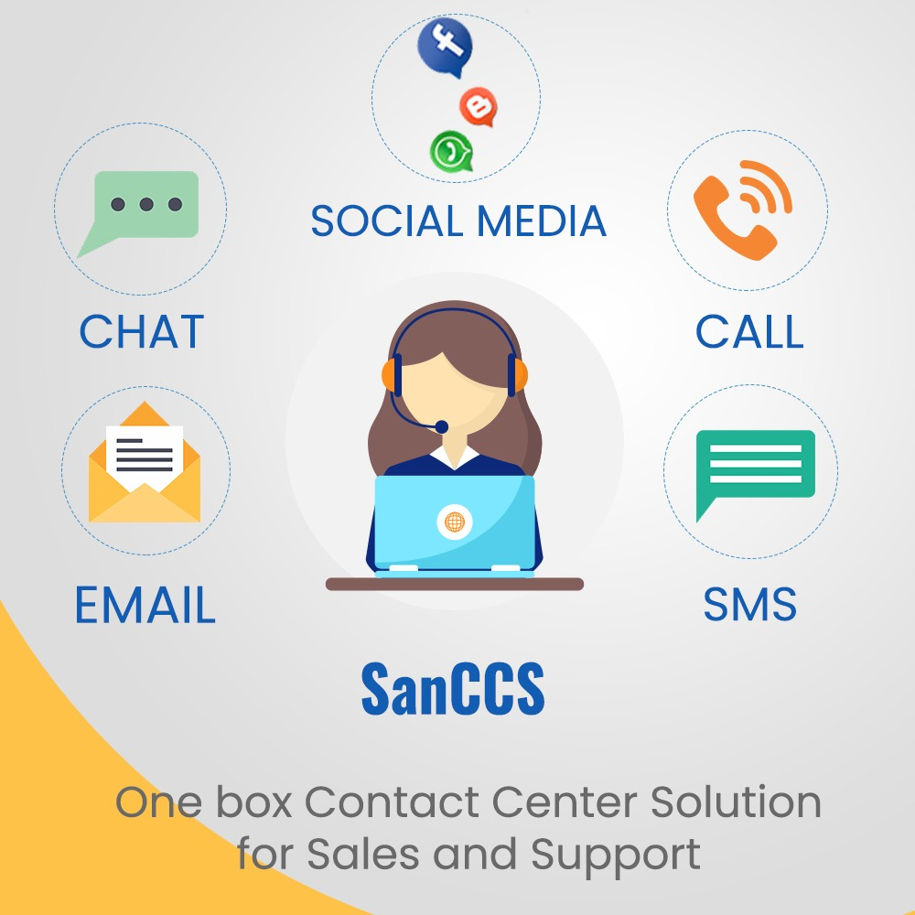
OUR SOLUTIONS

Slide 3
















Clients Using SanIPPBX

Slide 4
Who require
Contact center solution
Lead Generation
Customer Support
Order Booking
Feedback Calling
Survey Calling

Slide 5
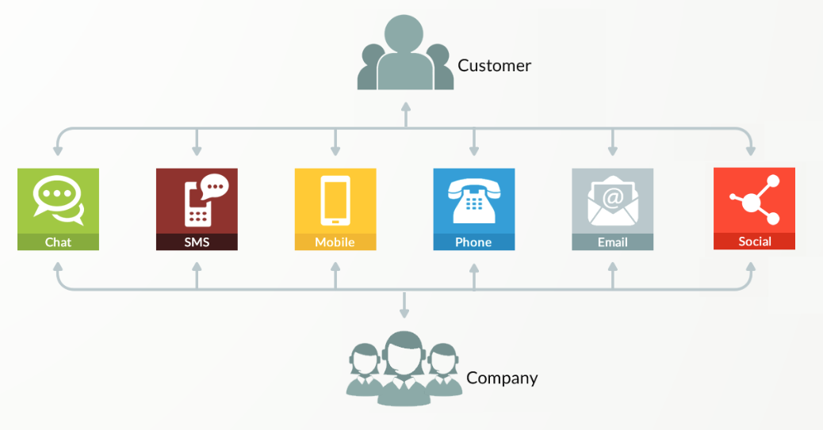
Solution Architecture

Slide 6

we can help in lead generation
Capture Lead : Website/Social Media/Sales Portals
Lead Assigning
Lead Follow up
Send Proposal
Close Lead

Slide 7
we can help in customer support
Customer Support
Hospitals
Education
Insurance
Auto Industry
Manufacturing
Travel
Assist Clients
Create Tickets
Information via IVR
Take Orders
Assign Engineer
Fix Appointments
Provide Training

Slide 8
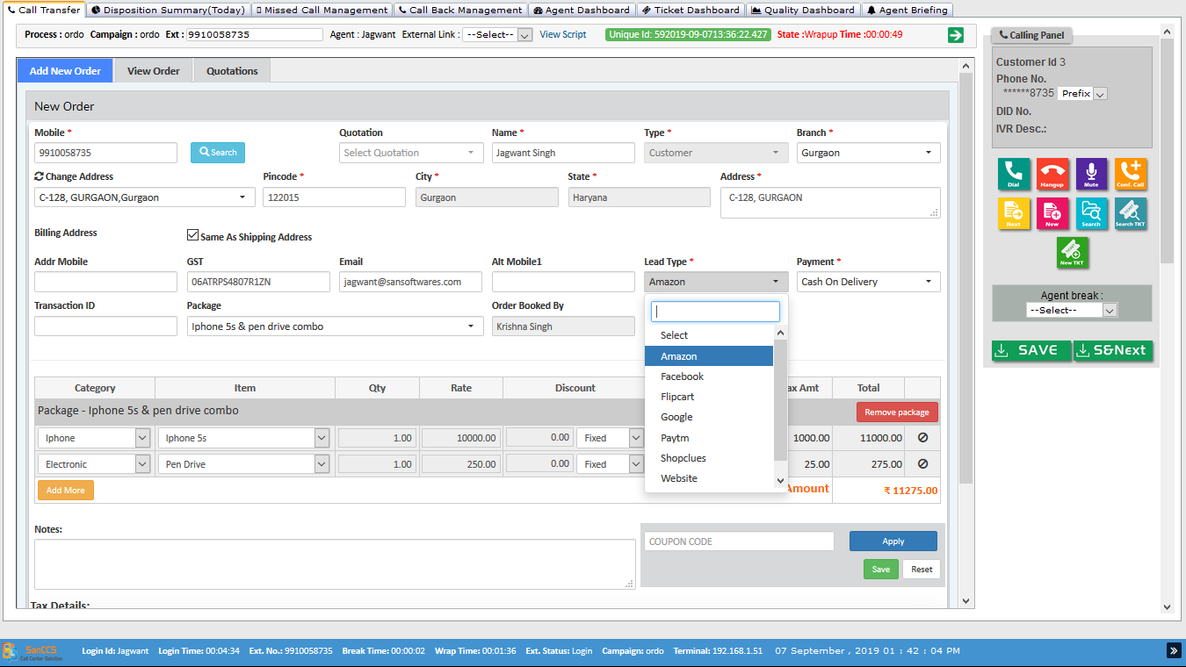
Order booking crm

Slide 9
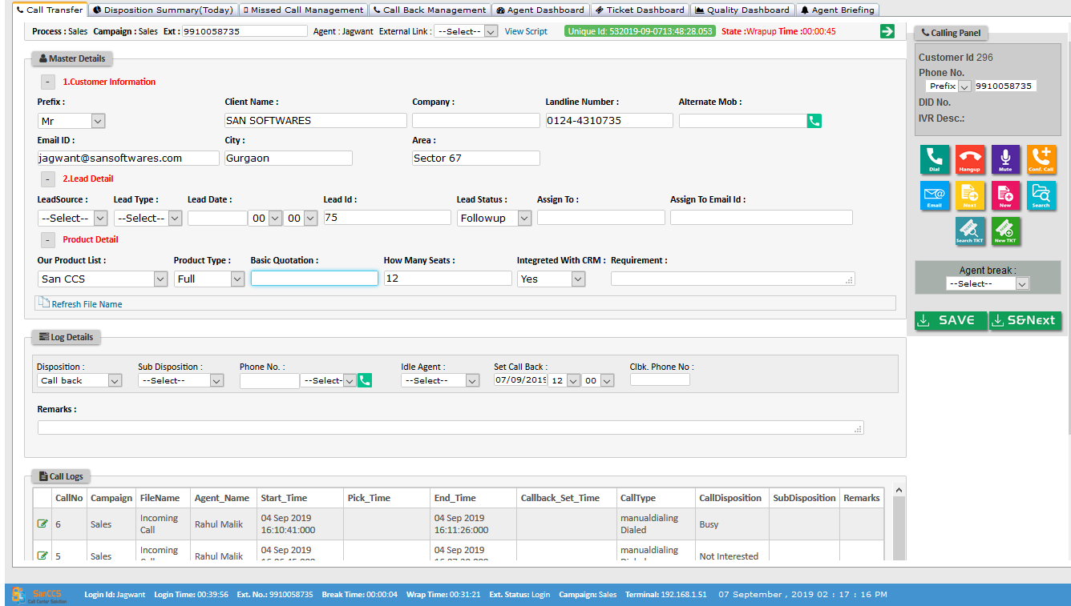
LEAD crm

Slide 10
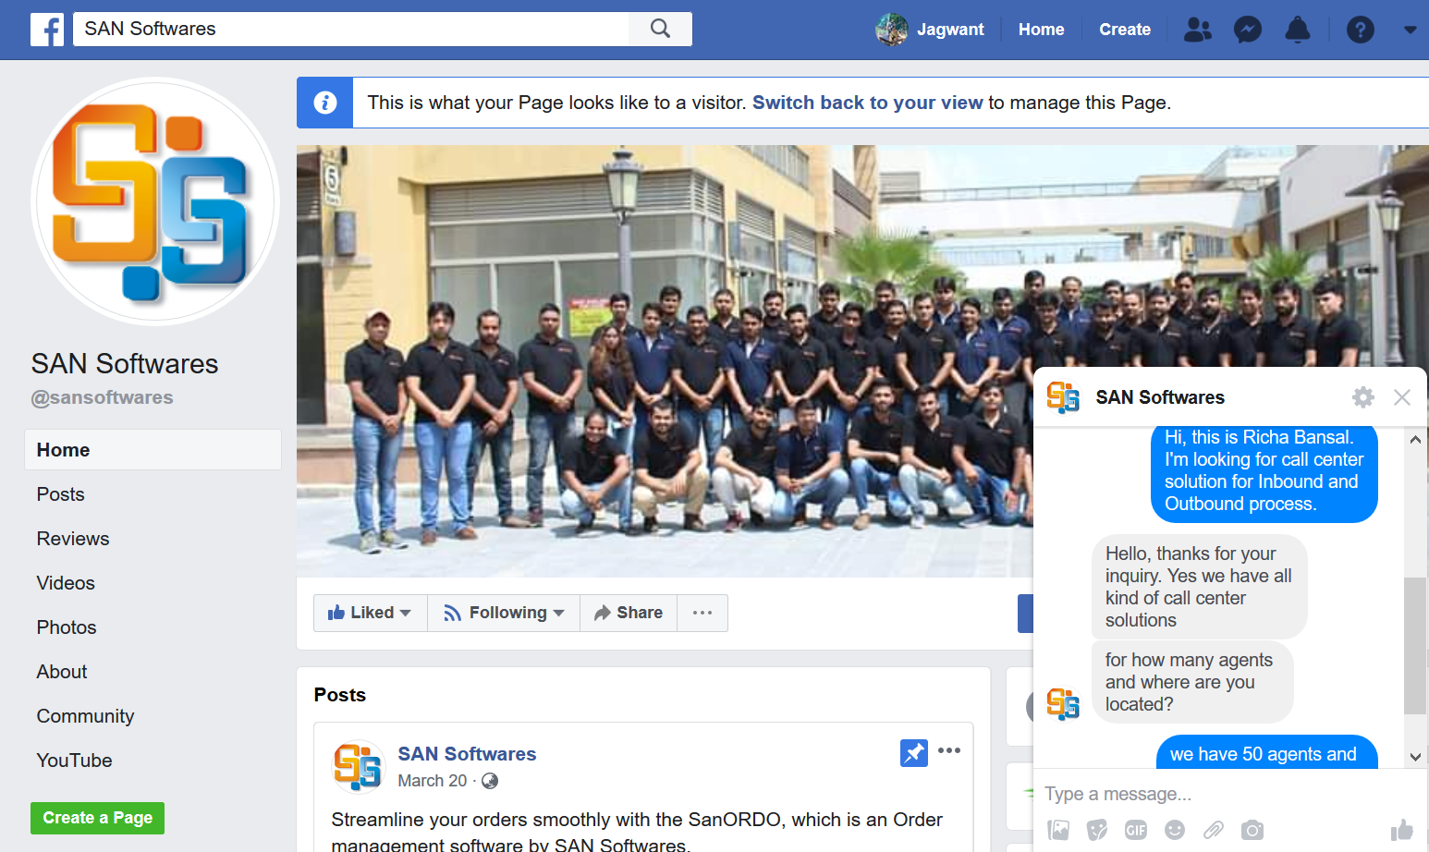
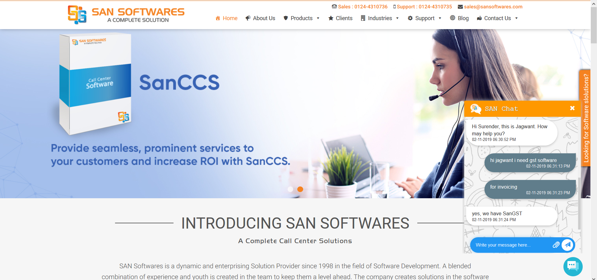
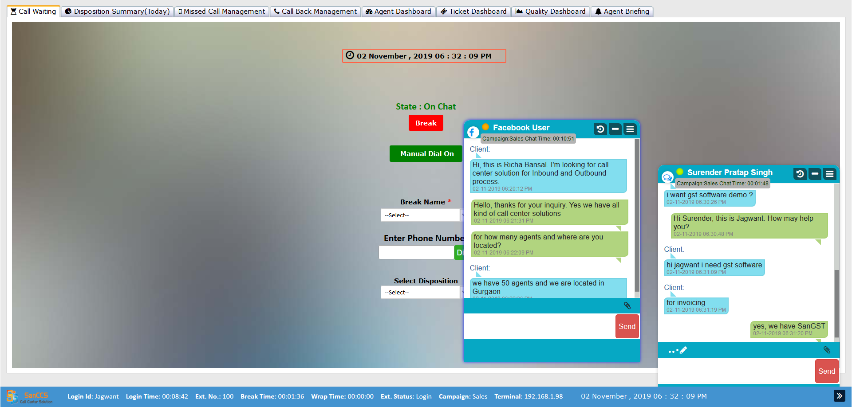
Omni channel integration

Slide 11
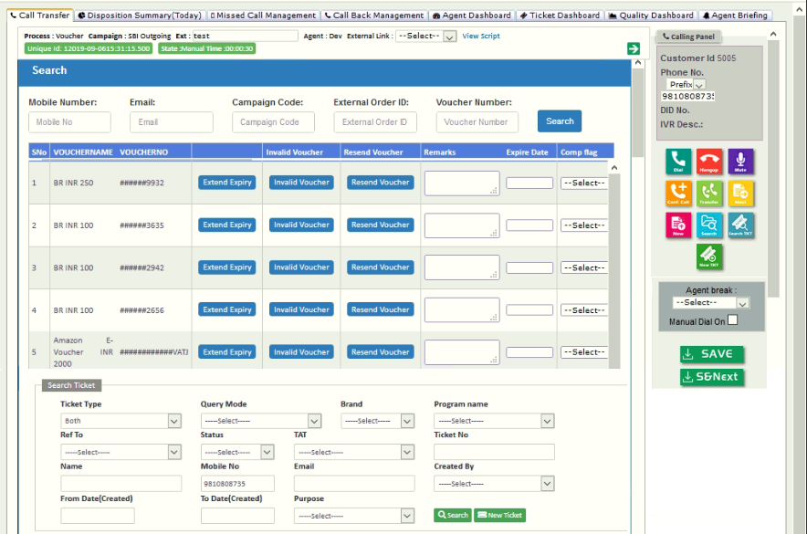
Crm layout

Slide 12
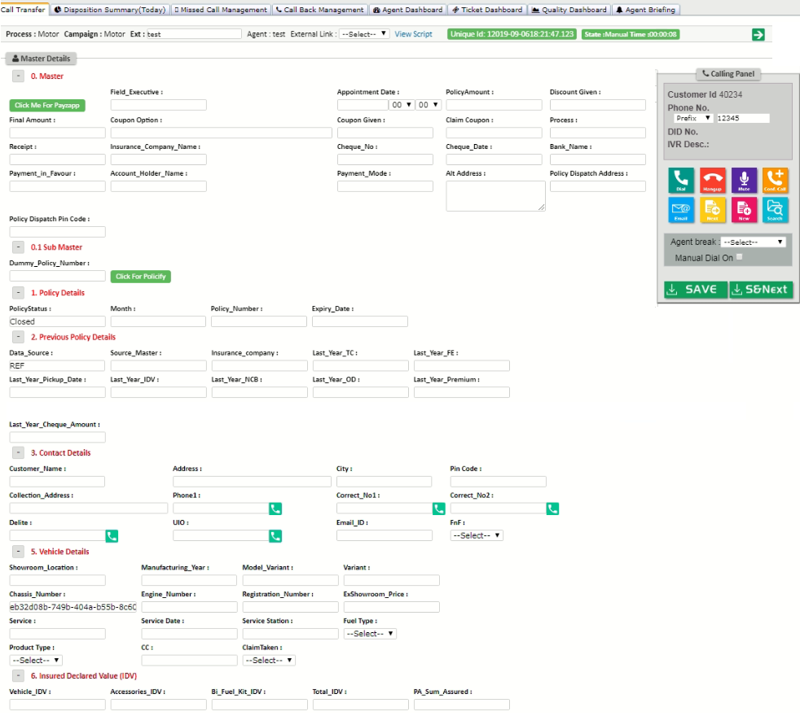
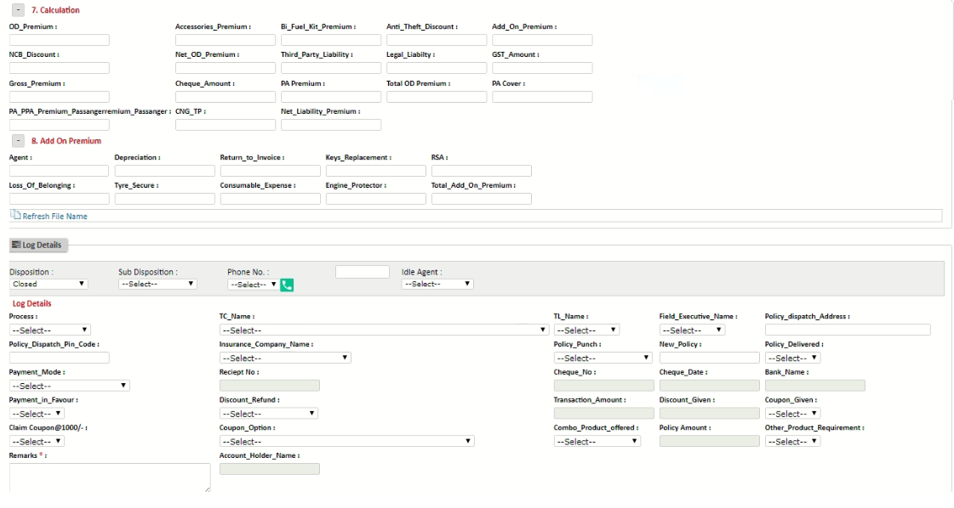
Insurance crm layout

Slide 13
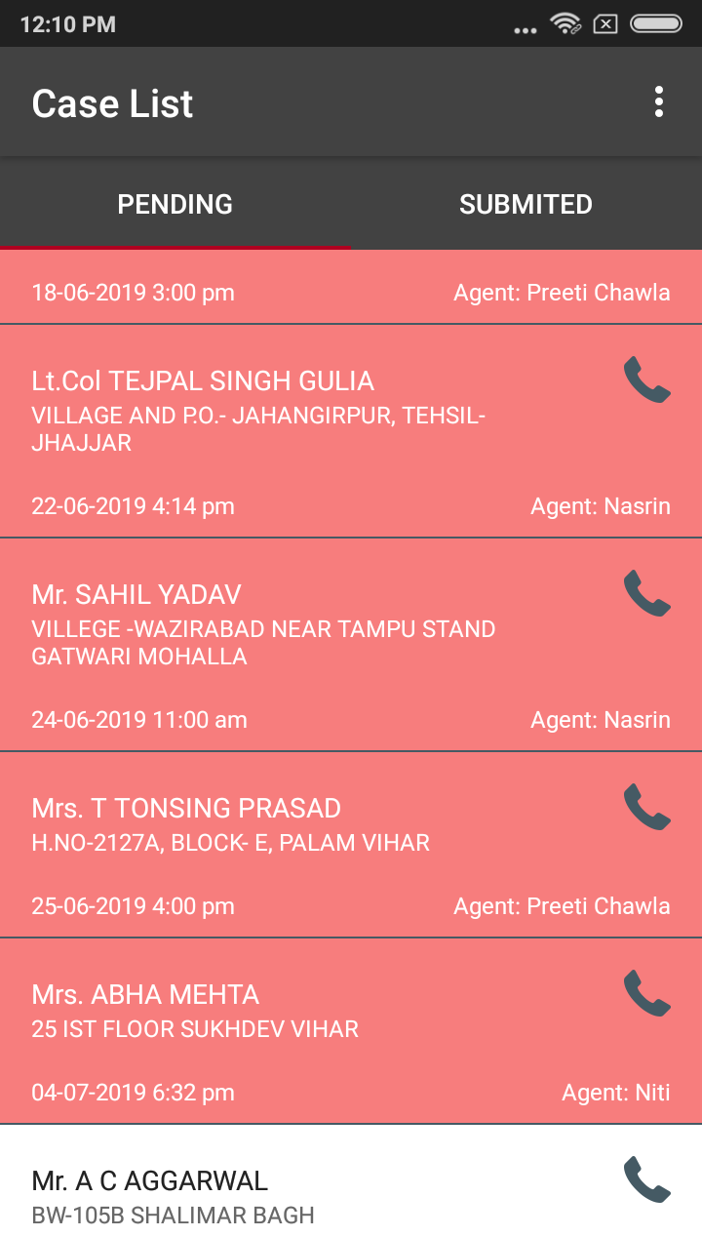
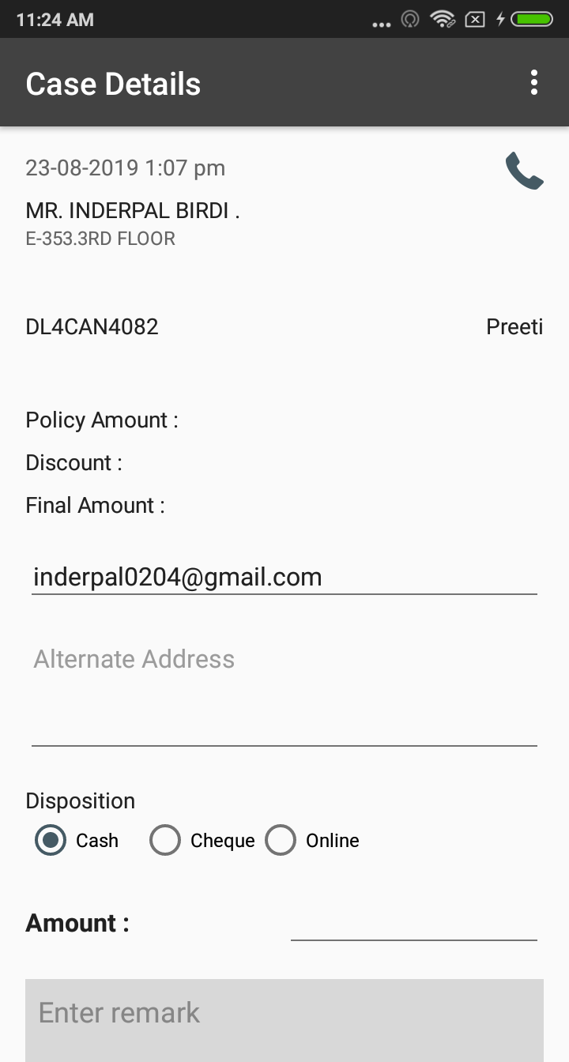
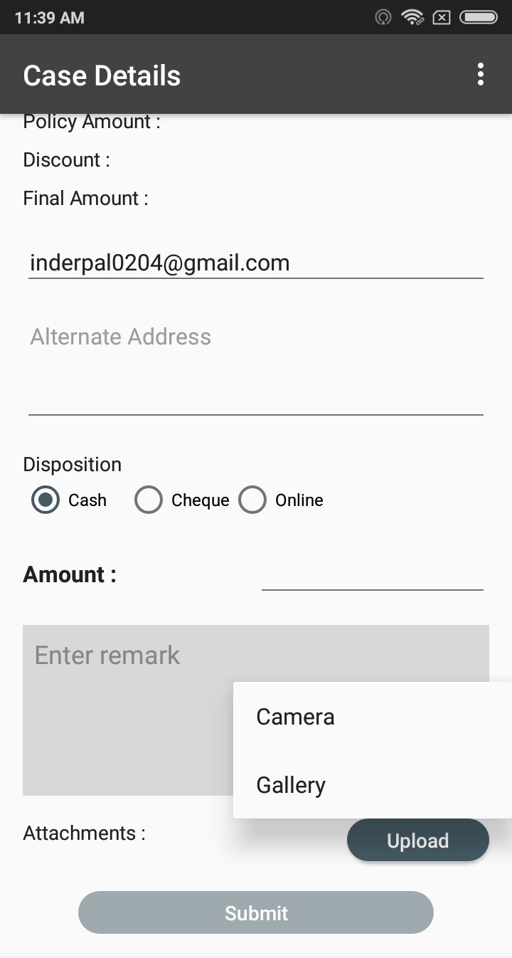
INSURANCE crm APP

Slide 14
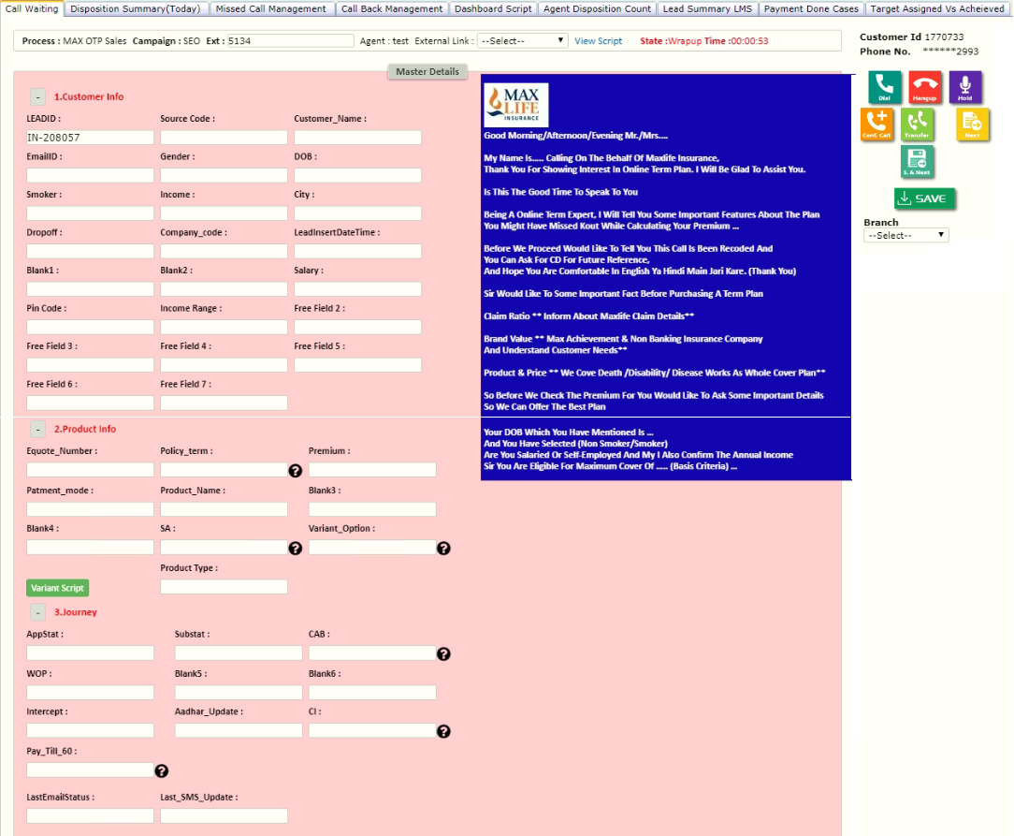
crm layout

Slide 15
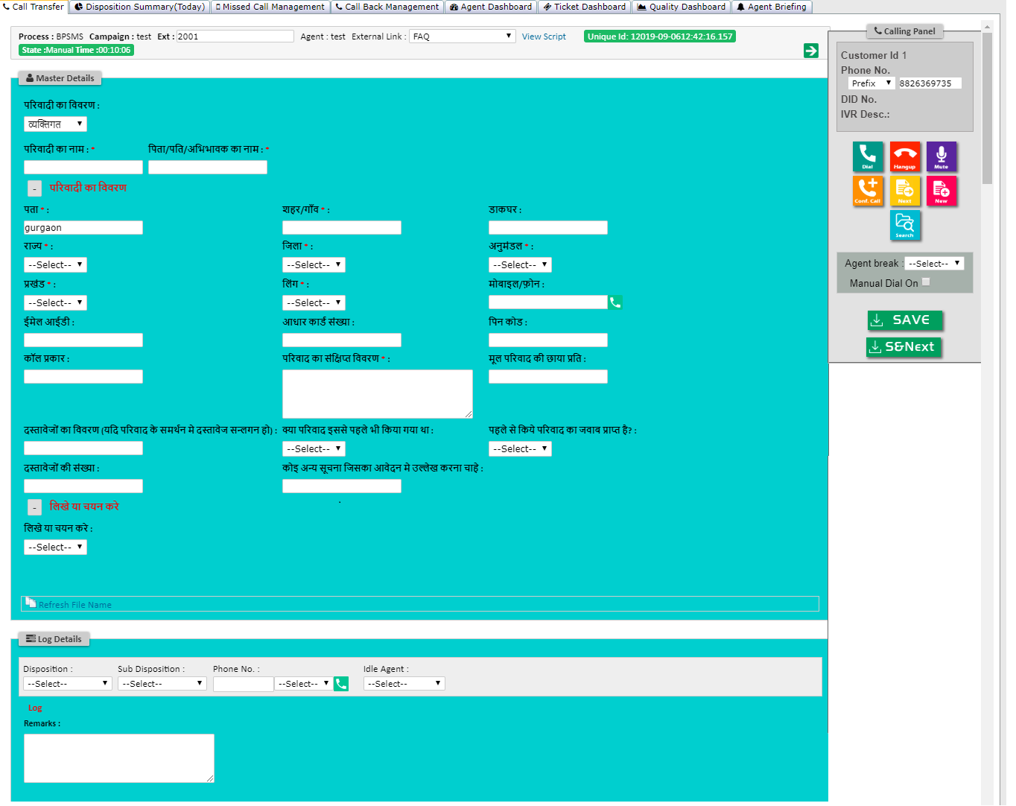
Survey crm layout

Slide 16
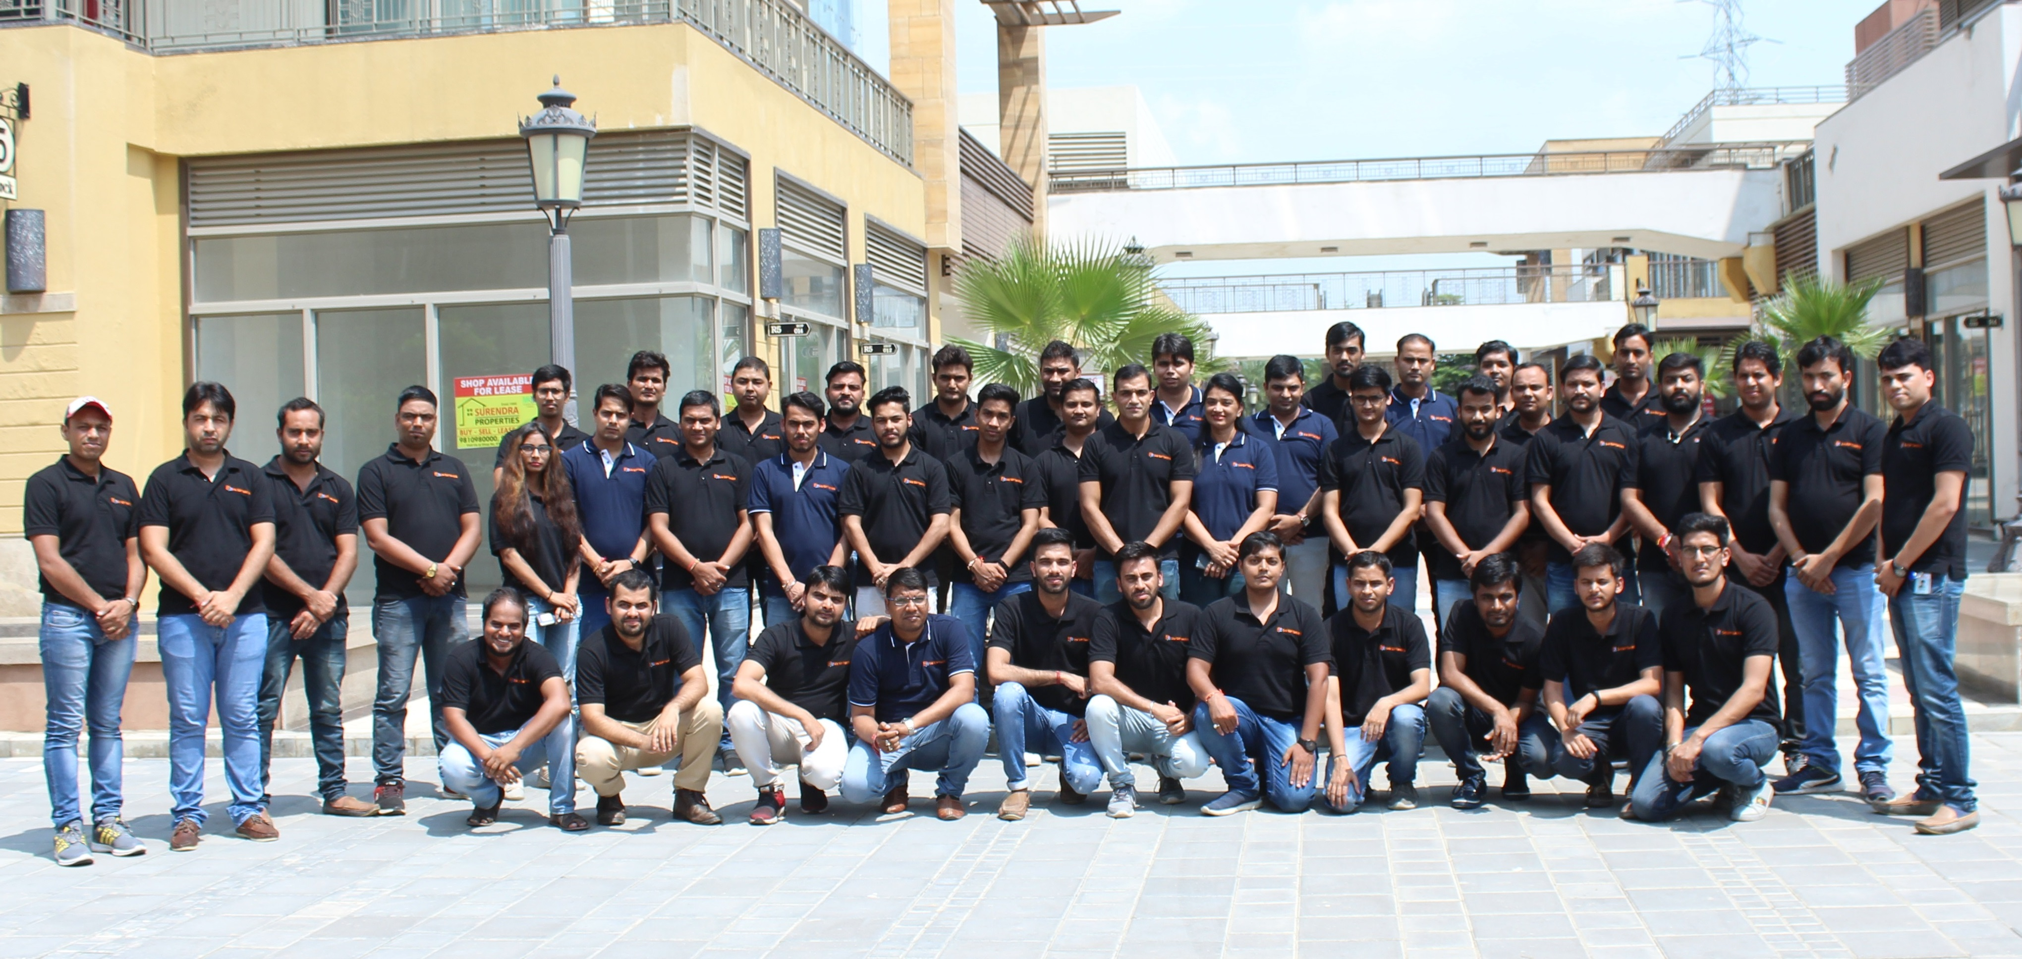
OUR TEAM

Slide 17
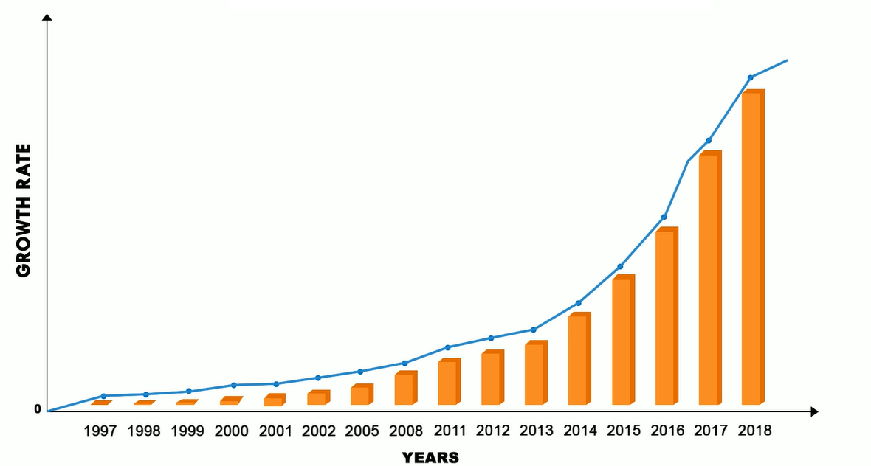
OUR GROWTH CHART

Slide 18
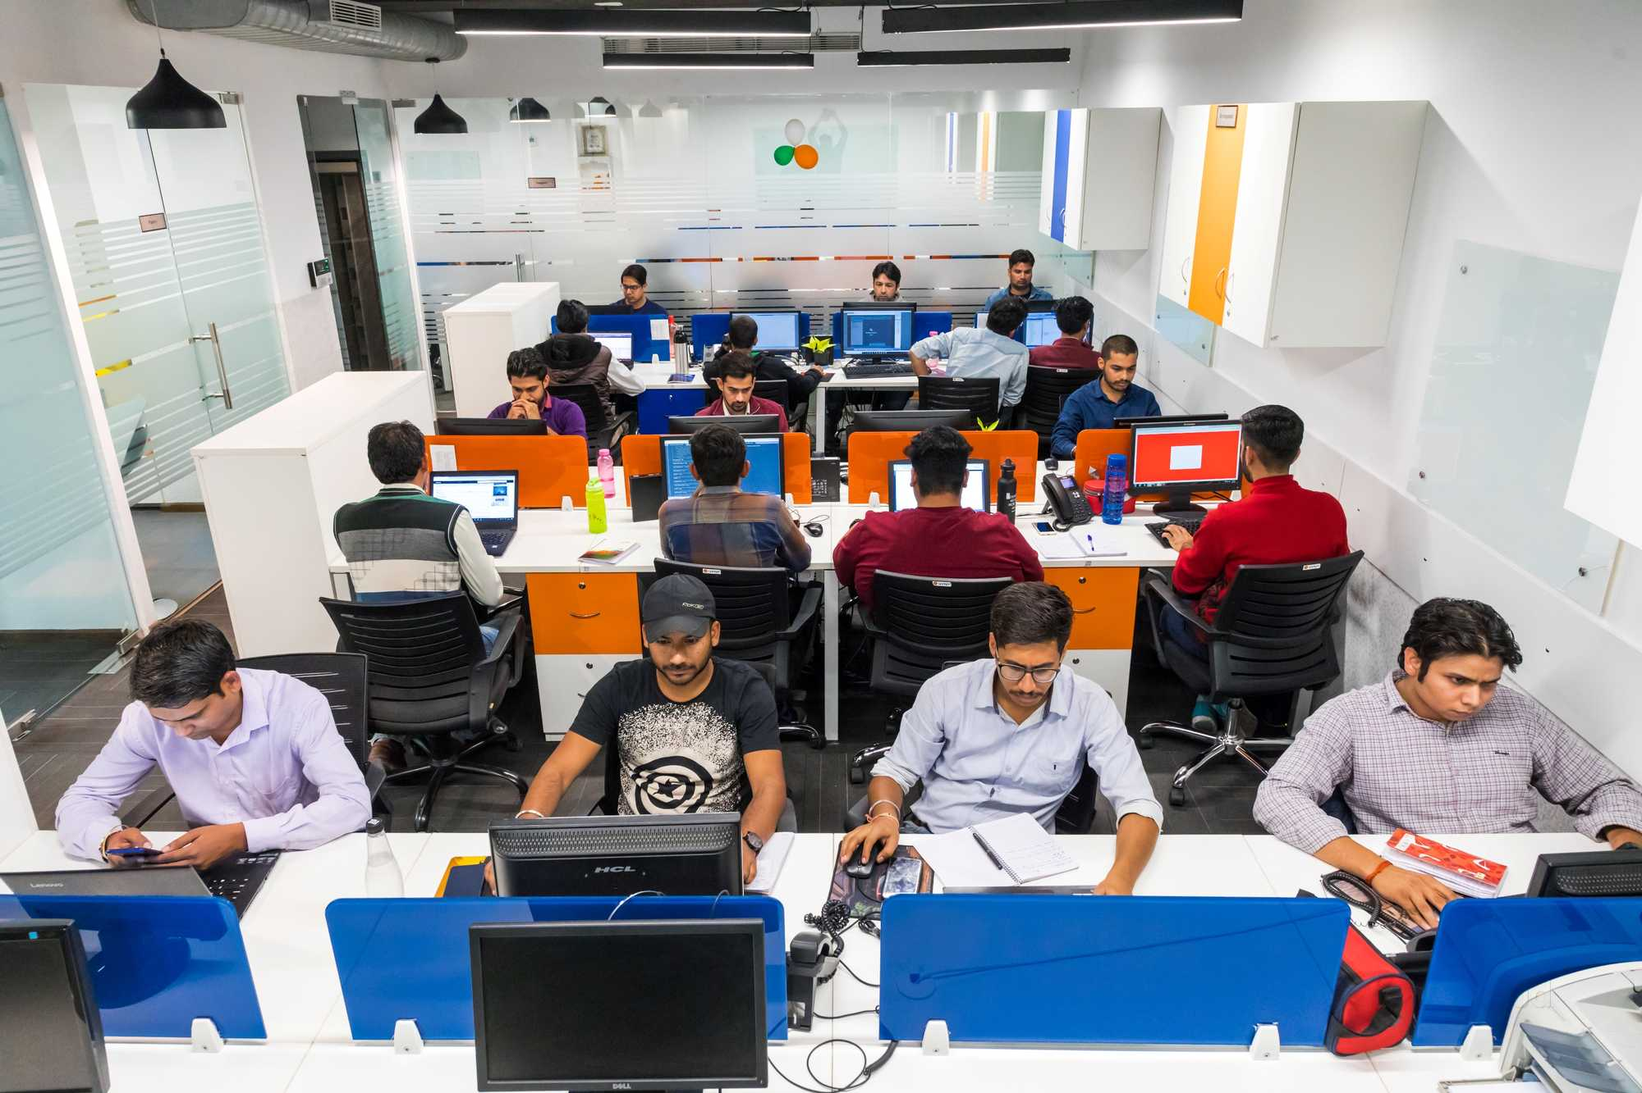
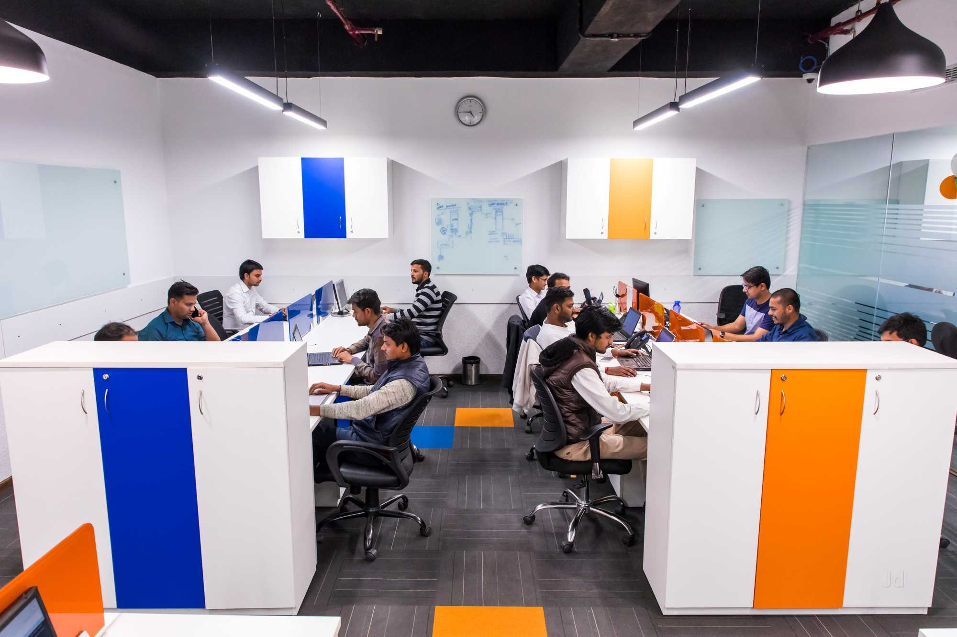
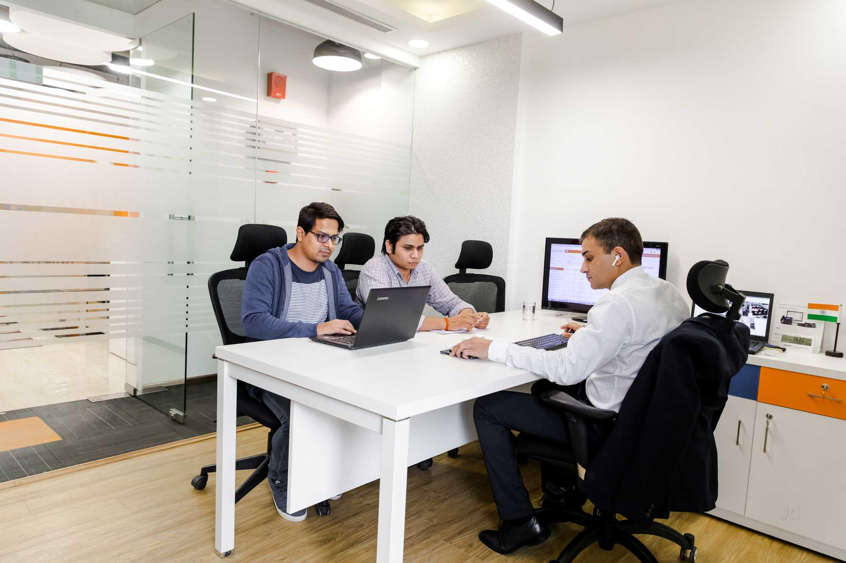
OUR office

Slide 19
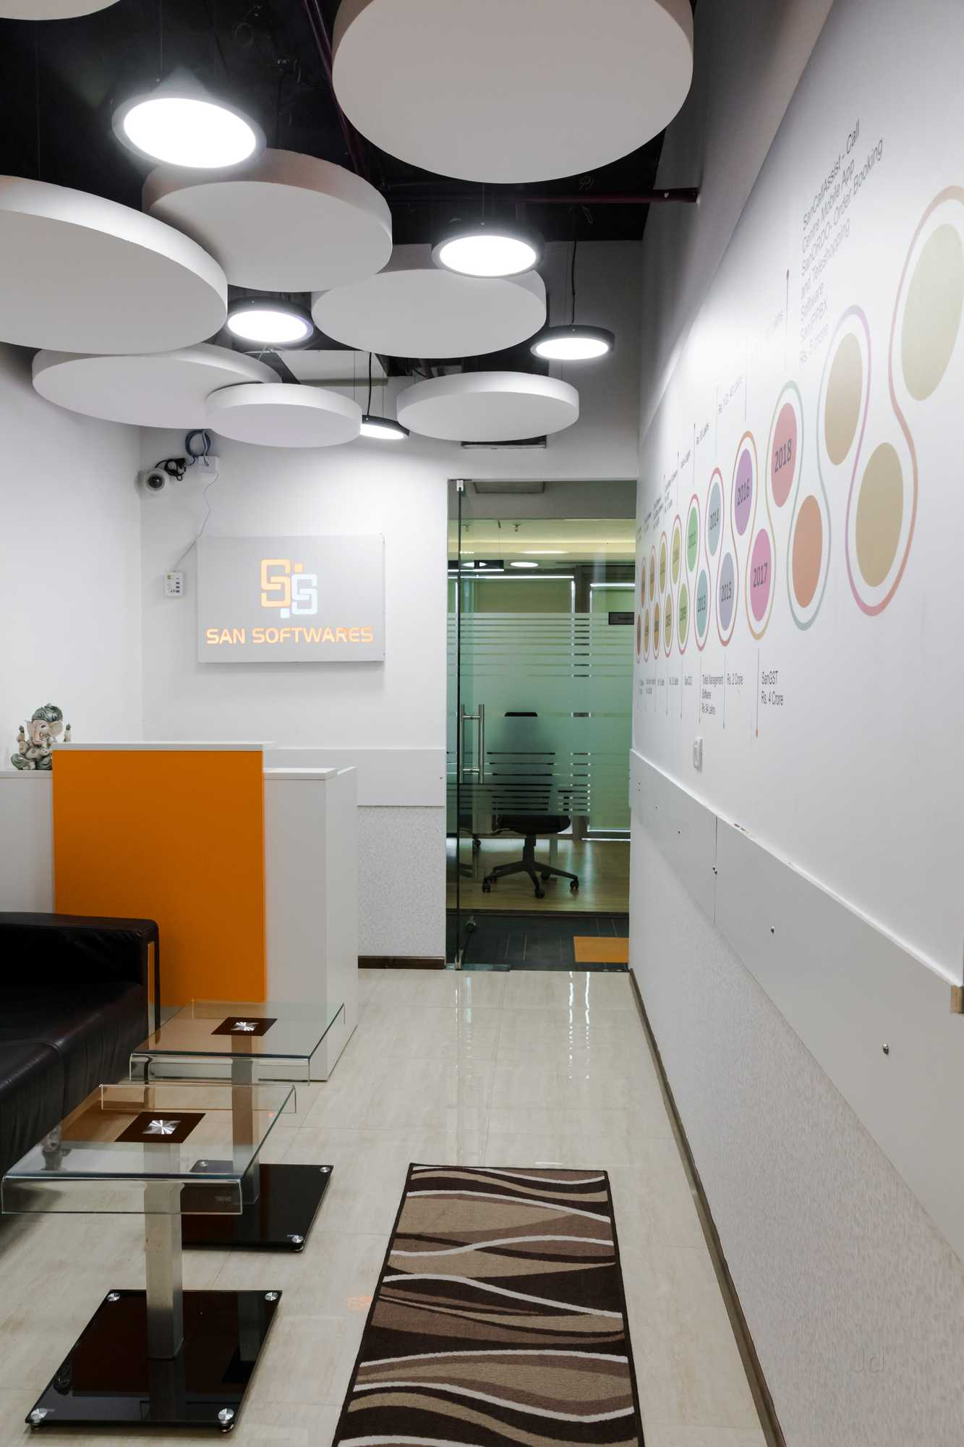
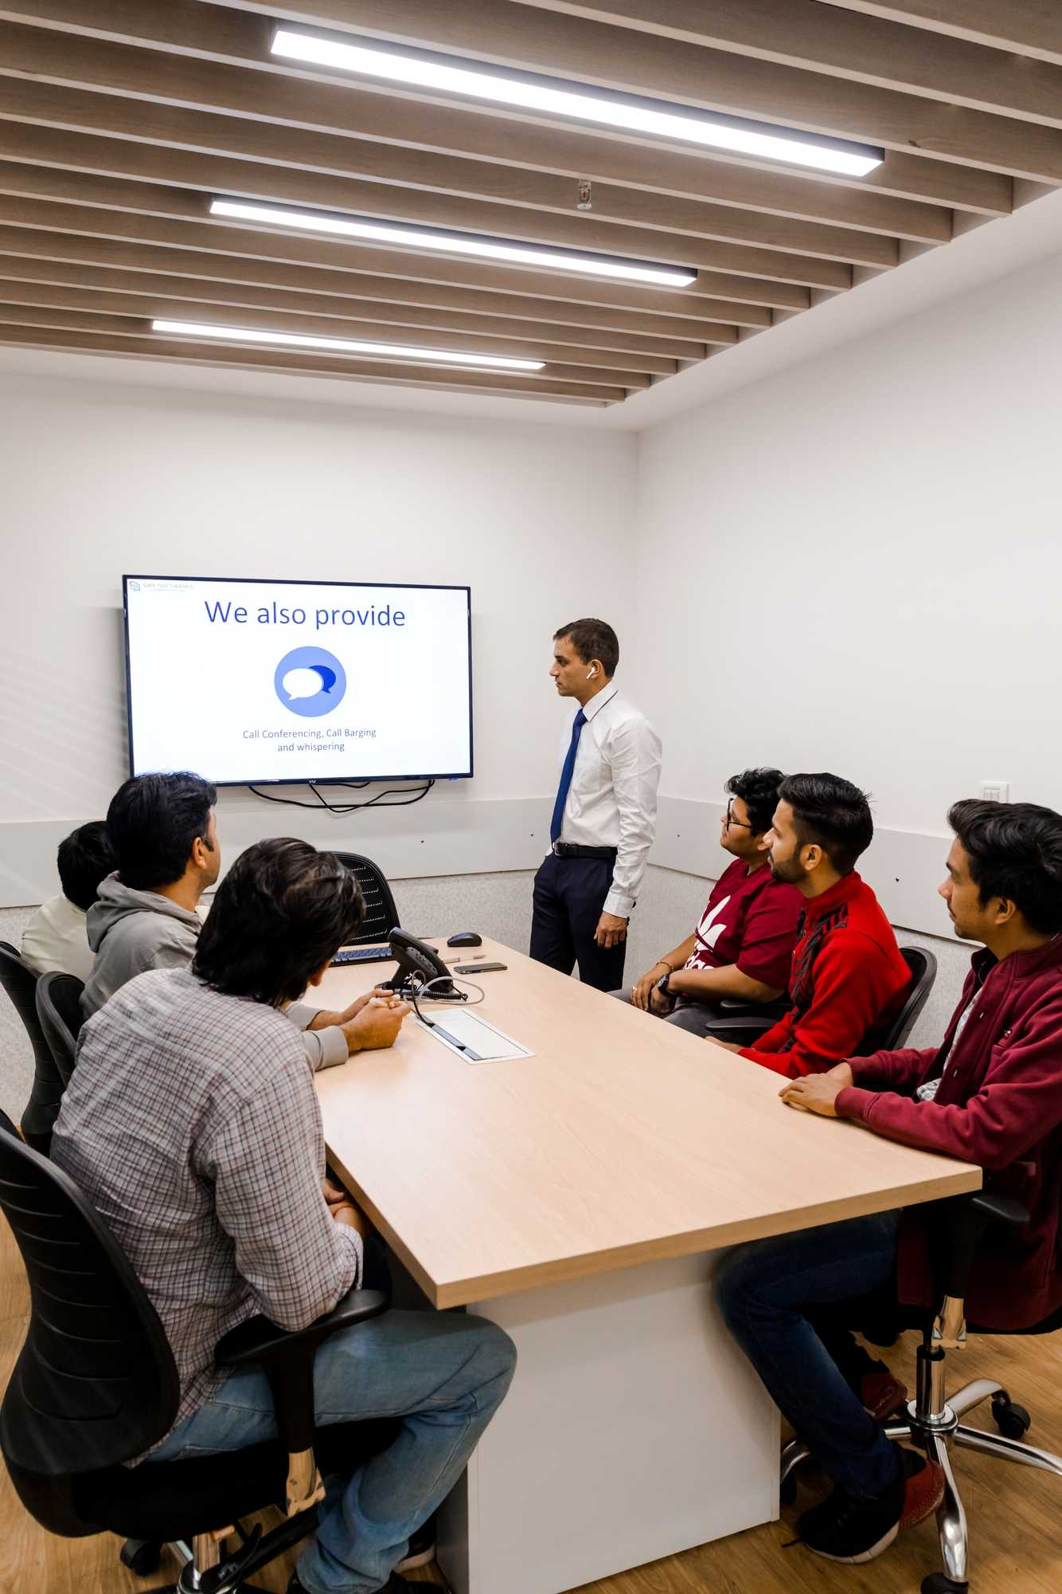
OUR office

Slide 20

OUR clients

Slide 21
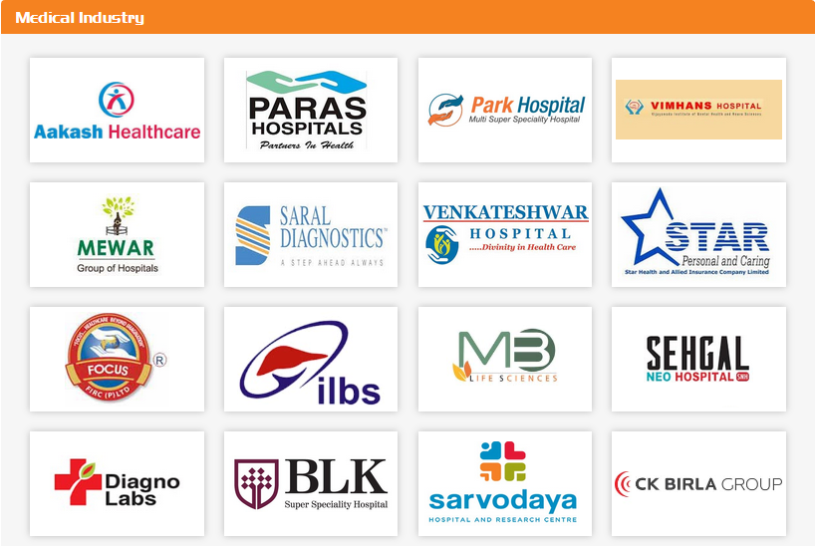
OUR clients

Slide 22

OUR clients

Slide 23
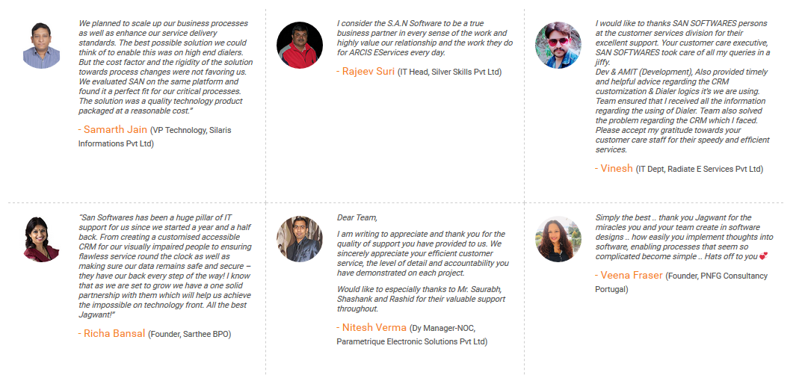
TESTIMONIALS

Slide 24
Best Contact Sphere
IT Hardware Provider
CRM Provider
Digital Marketing
Hospital Vendors
Office Furniture Supplier
HR Consultant
Architect Commercial
Malls and Housing Society Builders
ISP

Slide 25
Contact DETAILS
Thank you
SAN Softwares
419, 4th Floor, M3M Urbana, Sector 67, Gurgaon, Haryana-122018
Phone : 0124-4310735, 9810018735
E-Mail : sales@sansoftwares.com

