Slide 2
Company Profile
SAN Softwares is a leading name in the telecom industry ever since its inception in the year 1998. Promoted by group of young professional with vast experience in Telecom . SAN has emerged as one of the dominant market players offering total solutions to its customers - be it Voice or Data.
SAN portfolio of solutions cover the full range of communication needs, delivering highly flexible, reliable and cost effective solutions to suite the various needs of its customers with extensive scalability for investment”
We have emerged as a global software developer. The company is rapidly growing as a quality player in delivering both inshore and offshore software services.
We have expertise in Telecommunication Solution, IPPBX , Call Center Solutions, Unified Communications Call Billing Software, Call Logger Application .
San Softwares we diversify ourselves into this fast moving , competitive business environment ,we forced ourselves to establish a platform from where we can look into the higher-end requirements of our customers and providing them with a satisfactory solutions,
Contact Center Solution” is a step towards that ,
Depending on the business needs and the Company's financial investment decision a perfect solution is offered.
A testimony to the exemplary track record of is the endless list of customers it has built in the last decade and a like CANON INDIA, AMERPRISES INDIA, DELHI POLICE, CPWD, FCS SOFTWARE (P)LTD, SDG SOFTWARE ,KINGDOM OF DREAMS , to name a few.
We are proud to realized your motto
“ CUSTOMER SATIFACTION IS OUR FIRST PRIORITY.”
With enlarged know how , experience , skilled personnel and engineers, we endeavor to achieve some edge over the ‘POSSIBLE’ in the service of our esteemed clientage

Slide 4
Outbound
DB Server
Dialer
Campaign Management
Pacing
Rule Based Dialing
Third Party Integration
Check for Free Trunk
Mode : Predictive, Progressive, Preview
Transfer Positive Voice Calls
Supervisor
Agent Desk
MIS Reports
Voice Logger
Quality Management
Lead Management
Screen Popup
Call Log
Disposition Entry
Set Call Back
SMS/E-Mail

Slide 5
Inbound
IVR
ACD
IVR Designer
Time Condition
Multi Level Tree
DNI Based Routing
Intelligent Routing
Skill Based Routing
Mode : Round Robin, Ring All, Least Recent
Multi ACD Login
ACD Queue
Supervisor
Agent Desk
MIS Reports
Voice Logger
Quality Management
Lead Management
CRM Screen Popup
Call Log
Disposition Entry
Set Call Back
SMS/E-Mail

Slide 6
Customer Relationship Management
CRM
Process Designer
Multi Campaign
Branch Wise Allocation
Supervisor
Console
Lead Management
Over 100’s of Inbuilt Reports
Report Designer
Queue Graph
Back Office Management

Slide 7
Office PBX
Office PBX
IVR/Auto Attendant
Call Barging
Remote Barging
Remote Extension
Call Billing Software
Voice Logger
Voice Mail
Directory Service
Scheduled Call Back
IP/Analog Extensions
MOH
Call Transfer/Forwarding/Conference

Slide 8
SanCCS Redundancy Modes
Option 1: SanCCS HA Mode with PRI failover device. In this mode on failover of live server’s VM will instantly shift to backup server.
Option 2 : SanCCS Planned – You need to change the IP address and shift the PRI lines manually.
Option 3 : Without Redundancy. In this case we need 8-10 hours to reload server and need standby PRI card to replace.

Slide 9
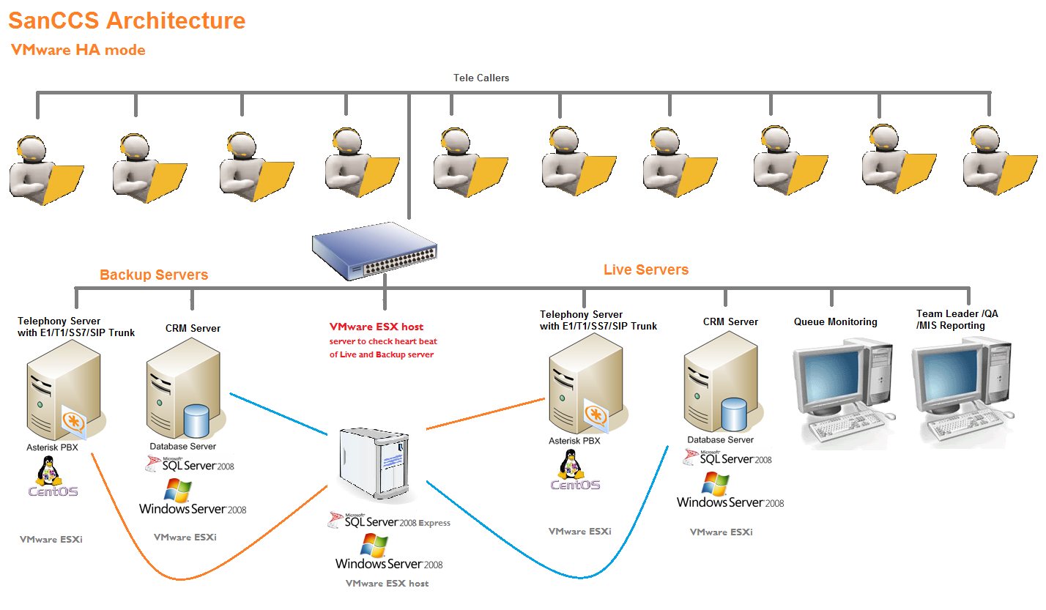

Slide 10
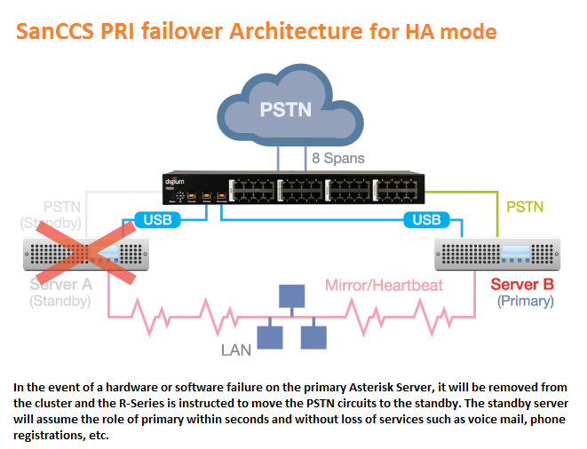

Slide 11
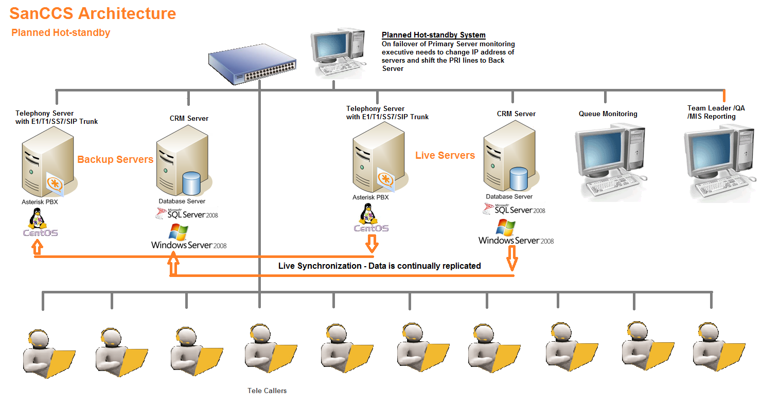

Slide 12
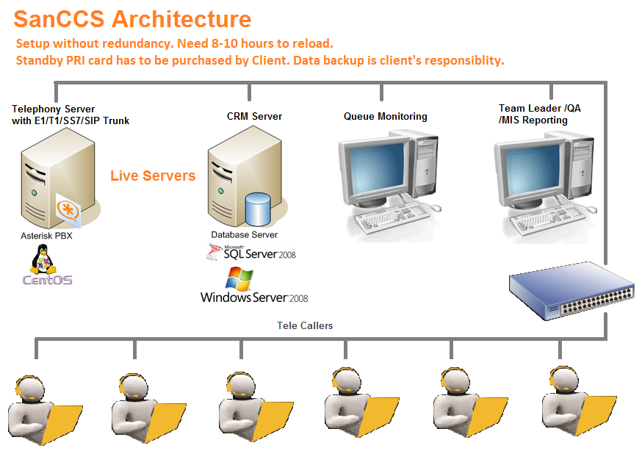

Slide 13
Support Models
We offer 3 kind of support model as per client requirement.
Online Support Model
Onsite Support Model
Resident Engineer Support Model
Online Support Model :- In this kind of we install remote support application on client server . After installing this application we can take remote anytime when anyone need support. Client can enable/disable the remote permission whenever required.
In this kind of support the SLA will be 99.99%.
Onsite Support Model :- In this kind of support if the complaint is launched in working hours will be attended within 4 hours .
Working Hours : 9 AM to 6 PM ( Monday to Saturday )
Non Working hours complaints will be attended on next working day.
Resident Engineers Support Model : In this kind of support the Resident Engineers will be at clients place in 8 hours shifts . If case of 24*7 supports is required client will require minimum 4 resident engineer.
In this kind of support the SLA will be 99.99%

Slide 14
When we started this company we use to develop customised software solution. In 1999 we started telecom billing solution for hardware based EPABX. In span of 4-5 years we almost covered half of India who were using CBS.
In 2005 EPABX manufacturer approached us to develop a Call Center Solution on their Telcom Switch. Since then we are into Call Center Solution .
In 2008 we switched to Asterisk the globally recognized platform for telephony in which we can integrate VOIP, SS7, ISDN. We developed our own CRM with keeping all the scenarios related to call centers. Day by day we are developing new features to become a leader in this field.
Our future plan is to expand globally. We have signed a first contract in Australia and many more to come.

Slide 15
Our Technologies
Our team works on below technologies :-

Slide 16
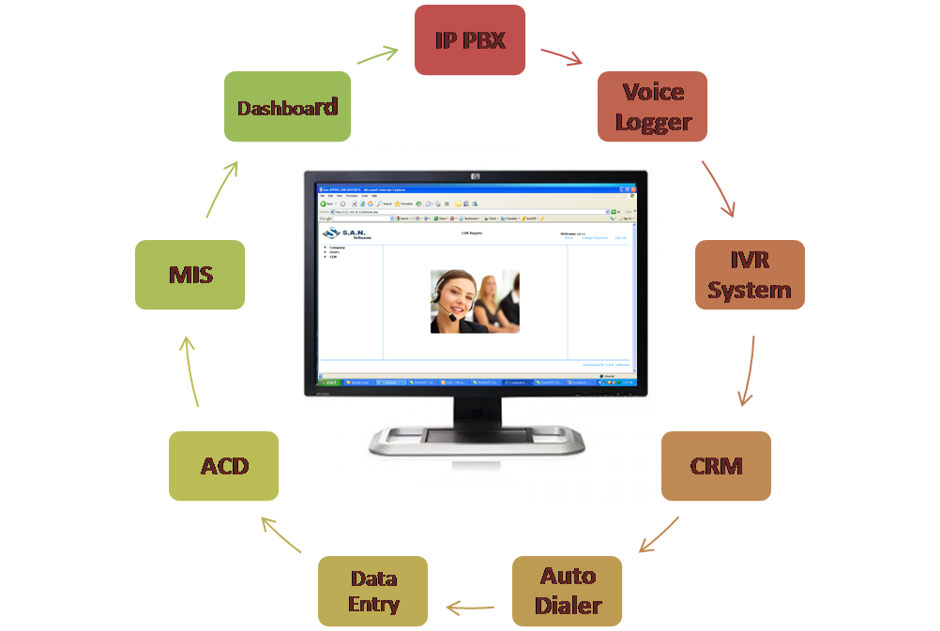
Integrated Solution
SAN presents an integrated advance IP based solution that offers integrated PBX, IVR, Voice Logger, CRM, Dialer and MIS.
The application provides you a self programmable module that erase the dependency on vendor. The SAN application also gives you freedom, flexibility, functionality, economy, performance & complete control. The system comes with advance MIS reporting engine that give it an edge over the other conventional Call Centre Solutions. Moreover, the self customization feature gives the users more conversable with the application.

Slide 17
IVR
SAN IVRS: An integral part of a call centre that enlighten the caller’s ears with melodious voice messages & guidance. We look at IVRS as a professional tool that helps the Call Centre to handle the call traffic smoothly and guide the caller to an appropriate call queue.
IVRS can also be designed to provide long information for which otherwise the manpower is used. This reduce the running cost and enhance the performance.
Unique Features:
Welcome to SAN Softwares
Multilayer options with Menu and Sub Menu’s | Multi-lingual options to cater zonal or international clients | Option to interface with database and convert data into voice
IVR Ports are non-blocking | Option to maneuver the call differently after every message | Flexible swappable wave files can be set

Slide 18
Voice Logger
SAN Voice Logger: A smart and intelligent software that provide complete voice recordings in office/ call centre setup. The application provides true voice quality and does deviate in the pitch, tone or volume of the conversation.
The Voice Jog can be tracked using the unique client ID, Phone number, or process specific tagging.
Unique Features:
Voice Recording
Recording Clarity | 100% recording | Custom Tagging
Low space / minimal file size | Helps in resolving critical issues | Low Maintenance

Slide 19
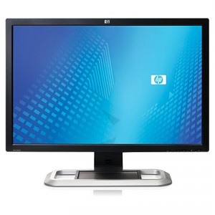
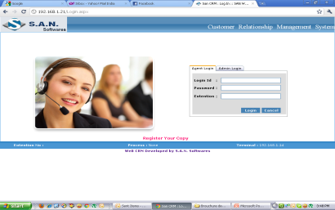
Screen Popup
SAN CRM – Screen POPUP: The front end for the agent is designed keeping various parameters in mind including the agent ease for usage and MIS. The Screen POPUP can be easily customized according to the clients process or processes. It provides call script and external links for agent to refer while talking to the client, variable disposition based Log Fields helps the agent for probing customer’s details and requirements. The Smart SMS and Email application linked with Call Disposition helps to send useful information instantly to the caller.
Unique Features:
Screen Pop-up
Master Fields
Log Fields
Smart SMS/ Email
Previous Log
Auto Call Back
External Links
Editable Master / Log Fields | Script and External Link s | Smart SMS / Email application
Log entry is converted automatically in a reporting format | Redial/ Dial option on screen to reconnect to the client | Live Call linked smartly with CRM to perform various checks

Slide 20
Reports
SAN CRM – MIS: the Bottom Line that speaks for the whole process. Reporting is the part that need to be flexible, in depth and creative. The module has been designed keeping all the above in mind and making it most flexible for the user to create their own Reporting Templates.
We have gone a level ahead and provide option for multiple Dashboard Templates with user rights. The dashboard helps the higher management to directly jump on to the desired reports after login to CRM.
Unique Features:
Customizable Reporting Format | Provision to export in excel with user rights | Dashboard Templates with user rights
User definable filters in reporting format | Also helps the operational staff to gain details | Essential for strategic management decisions

Slide 21
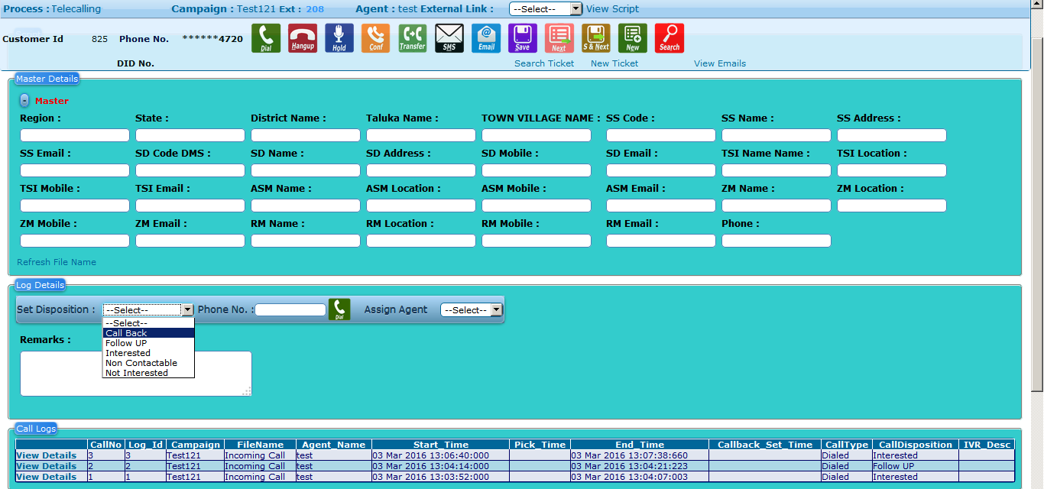
Agent Screen

Slide 22
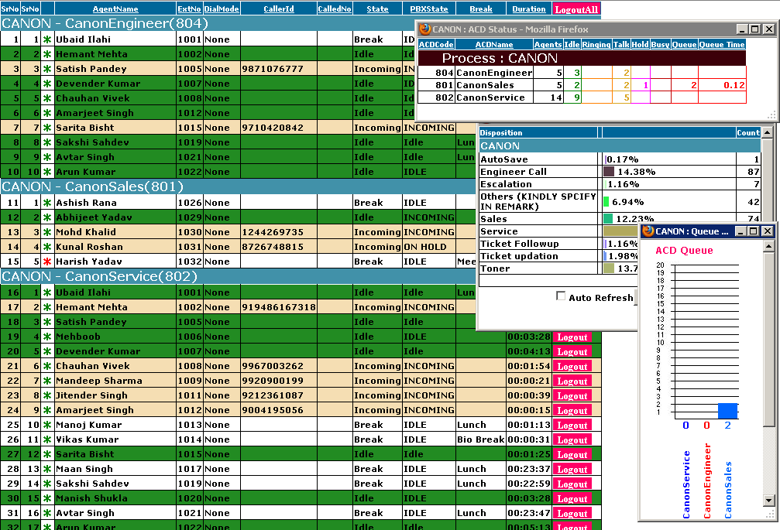
Supervisor Module

Slide 23
Features Summary
IVR - Multilayer options with Menu and Sub Menu’s | IVR-Flexible swappable wave files can be set | Voice Mail
Remote Extensions | Live Barging – Onsite/Remotely | SMS/E-Mail Templates and Integration disposition wise. SMS/E-Mail Blasting.
Self Designable Web Based CRM | Self Definable Dispositions | Multi Process
Multi Campaign with Dialing Mode, Pacing, Wrap up & Disposition wise Calling | Inbound, Outbound or Both Call Setup | Call Billing Software
Trunk Wise Billing | Extension Wise Billing | Multilevel STD Table
Dialing Mode : Manual, Preview, Progressive or Predictive | 100% Call Recording | Call – Voice Log Filtering by Process, Campaign, Date, Agent Name, Disposition etc wise
Multi Alternate Number Dialing | Real-time Statistics | Call Back Scheduling
Multi ACD | Self Designable Quality Process & Reports | ACD/Agent Management Reports
User / Group Rights | Agent/Branch Wise Data Uploading | Data Management with Do Not Call, Start Calling, Stop Calling, Call Again
Import Data from Excel/CSV | Process Hours | Directory Service
Customizable Reporting Format | Provision to export in excel with user rights | Dashboard Templates with user rights
User definable filters in reporting format | Also helps the operational staff to gain details | Back Office Self Designable Process

Slide 24
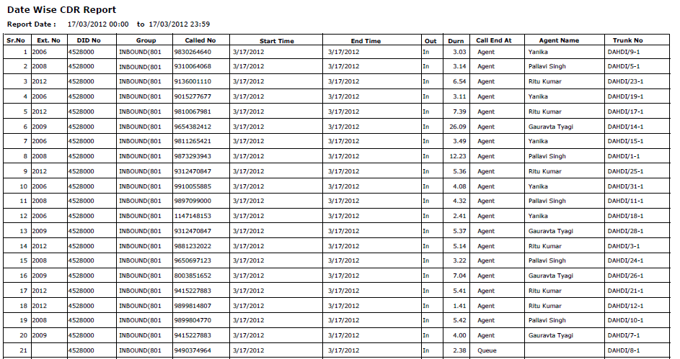
CDR Reports

Slide 25
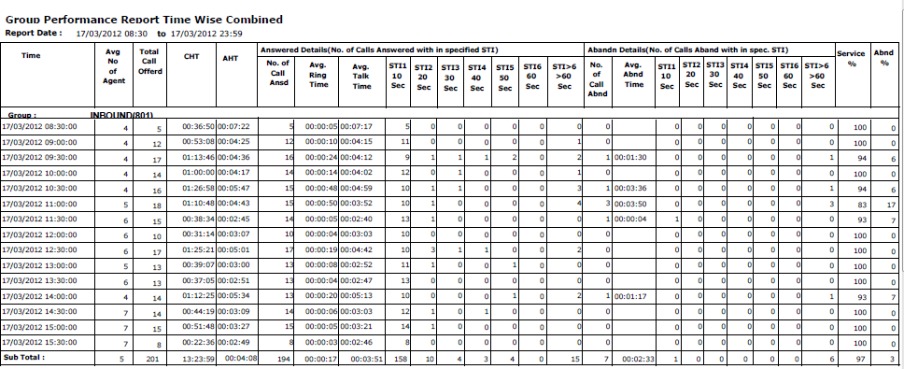
Group Performance Time Wise

Slide 26
Group Performance
Group Queue

Slide 27
Quality Management Report
SrNo | Agent Name | ContactNo | Type_of_Call | Audit_Dt | Date of call | Branding Total Point | Branding Score | Branding % | Comm Total Point | Comm Score | Comm % | Customer Handling Total | Customer Handling Score | Customer Handling % | Process Knowledge Total Point | Process Knowledge Score | Process Knowledge % | Total % | FAR% | NFAR%
1 | Akshay Mago | 1142648187 | Toner booking | 03/19/2012 | 03/17/2012 | 4 | 2 | 50 | 29 | 27 | 93 | 12 | 7 | 58 | 41 | 41 | 100 | 89 | 100 | 83
2 | Akshay Mago | 8025455029 | Service | 03/19/2012 | 03/17/2012 | 6 | 2 | 33 | 27 | 23 | 82 | 12 | 7 | 58 | 26 | 26 | 100 | 81 | 85 | 83
3 | Amit Kumar | 9741153523 | Service | 03/19/2012 | 03/18/2012 | 6 | 4 | 66 | 27 | 25 | 92 | 12 | 12 | 100 | 41 | 41 | 100 | 95 | 100 | 91
4 | Amit Kumar | 9925027878 | Service | 03/12/2012 | 03/18/2012 | 4 | 2 | 50 | 25 | 21 | 80 | 12 | 7 | 58 | 26 | 26 | 100 | 83 | 85 | 87
5 | Deepak Pathak | 919619004467 | Service | 03/19/2012 | 03/18/2012 | 4 | 4 | 100 | 27 | 23 | 85 | 12 | 7 | 58 | 26 | 26 | 100 | 86 | 85 | 91
6 | Deepak Pathak | 9739356669 | Toner booking | 03/19/2012 | 03/18/2012 | 4 | 4 | 100 | 27 | 25 | 92 | 12 | 10 | 83 | 41 | 41 | 100 | 95 | 100 | 91
7 | Jitender Singh | 9650205177 | Service | 03/19/2012 | 03/18/2012 | 8 | 6 | 75 | 27 | 27 | 100 | 12 | 12 | 100 | 41 | 41 | 100 | 97 | 100 | 95
8 | Jitender Singh | 9718120934 | Service | 03/19/2012 | 03/18/2012 | 8 | 4 | 50 | 27 | 27 | 100 | 12 | 12 | 100 | 41 | 41 | 100 | 95 | 100 | 91
9 | Pardeep Kumar | 9810255540 | Toner booking | 03/19/2012 | 03/18/2012 | 6 | 2 | 33 | 27 | 23 | 85 | 12 | 12 | 100 | 41 | 41 | 100 | 90 | 100 | 83
10 | Pardeep Kumar | 9953334376 | Service | 03/19/2012 | 03/18/2012 | 6 | 2 | 33 | 27 | 25 | 92 | 12 | 12 | 100 | 41 | 41 | 100 | 93 | 100 | 87
11 | Rahul Rawat | 8860012318 | Toner booking | 03/19/2012 | 03/18/2012 | 6 | 2 | 33 | 27 | 25 | 92 | 12 | 12 | 100 | 41 | 41 | 100 | 93 | 100 | 87
12 | Rahul Rawat | 9870042233 | Engineer | 03/19/2012 | 03/18/2012 | 6 | 2 | 33 | 25 | 20 | 80 | 7 | 7 | 100 | 26 | 26 | 100 | 85 | 100 | 79

Slide 28
Testimonials
I have 1st hand experience of SAN Softwares. It is innovation at its best. The brain behind this concept of the call centre solution in my words has created a Miracle. It is like magic you can get any of your processes automated at a click of the button. What makes you guys the best is your after sale service. your turn around time on any requirement or support asked. You guys are By far the best in my experience :) So keep up the GREAT work.
Veena Krishnan
HOD - Tele Sales Operations
Frankfinn Air Hostess Training Institute
I am writing this to express my gratitude for the high quality Services and professionalism that you are in particular and your pre and post Sale and Service team provide to the Canon India Pvt. Ltd on a regular basis.
S.A.N Software, have become one of the most trusted business partners at Canon India Pvt. Ltd.
S.A.N has provided us the best services to setup a 24 PRI for 250 Users total CTI Applications including Inbound, Outbound, Email unification, Chat, IVR, Voice Logger, QMS, User Application, Live Monitoring, SMS Facilities and much more.
There have also been numerous times that S.A.N Softwares have gone the "extra mile" to fulfill our requirements and performed tasks exceptionally.
I consider the S.A.N Software to be a true business partner in every sense of the work.
Sincerely, Tarun Arora
HOD – Sales & Marketing
Canon India Pvt. Ltd.

Slide 29
Our Valuable Clients

Slide 30
Service Level Management
The Following escalation matrix shall be followed for resolution of calls under this agreement:
Level of Escalation | Name | Designation | Phone No | Email-ID
1 | SAN Support | Support Executive | 9810018735 | support@sansoftwares.com
2 | Anuj Kumar | Support Head | 9810610735 | anuj@sansoftwares.com
3 | Jagwant Singh | IT Head | 9910058735 | jagwant@sansoftwares.com

Slide 31
Contact Details

