Slide 1
Welcome to SAN SOFTWARES PVT LTD

Slide 2
OUR INCEPTION
SAN Softwares was incepted by Mr. Jagwant Singh in the year 2000 with a vision to provide "Best Solutions to our clients".
For our clients, we place great emphasis and focus on their problems and goals so we can develop solution that best fits your needs
1500+ Satisfied Customers Worldwide!
Currently SAN Softwares is serving more than "1500 clients across the globe". And all they have for us is praises as we have always been able to provide exactly what they need
For more information please visit : SAN Softwares

Slide 3
HELLO!
I am Jagwant Singh
(Founder/Director)
I am here to present my company
SAN Softwares Pvt. Ltd.

Slide 4
The world of Cloud telephony
1
Let’s jump into it!

Slide 5
Above 70% companies/business are looking for cloud telephony services or are investigating about it. This is because of the ease of access and work from home possibilities in the COVID times.

Slide 6
Benefits of Cloud Telephony
Ease of access
World wide connectivity
Cost effective, saves on In-House Infrastructure
Apart from these benefits using cloud telephony one gets a chance to expand their business exponentially by expanding their roots world wide.

Slide 7
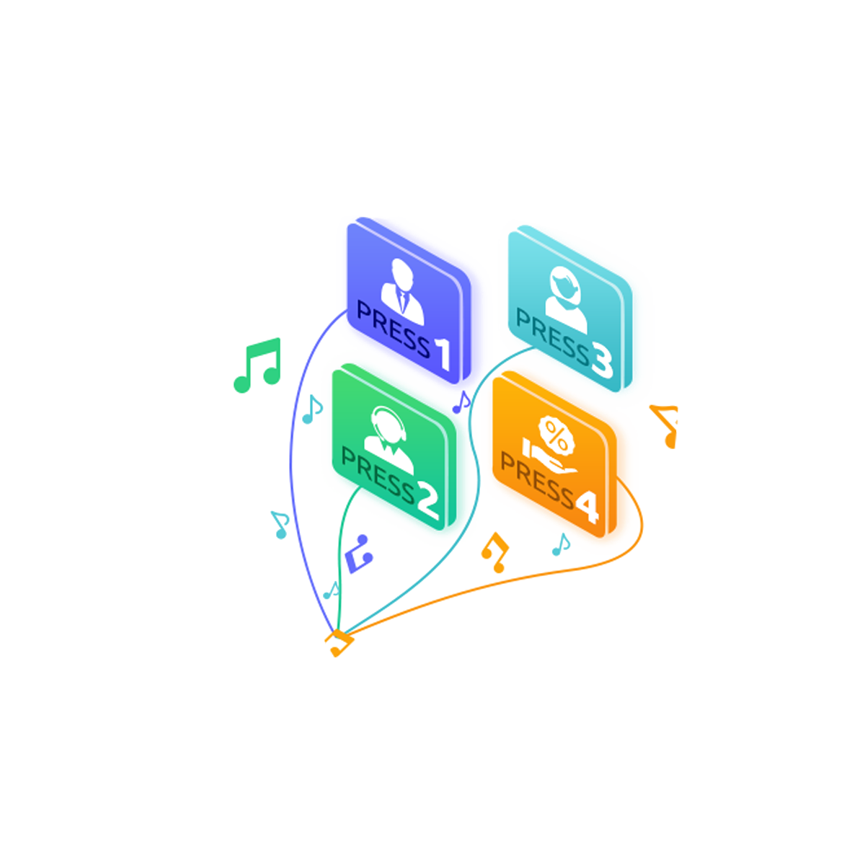
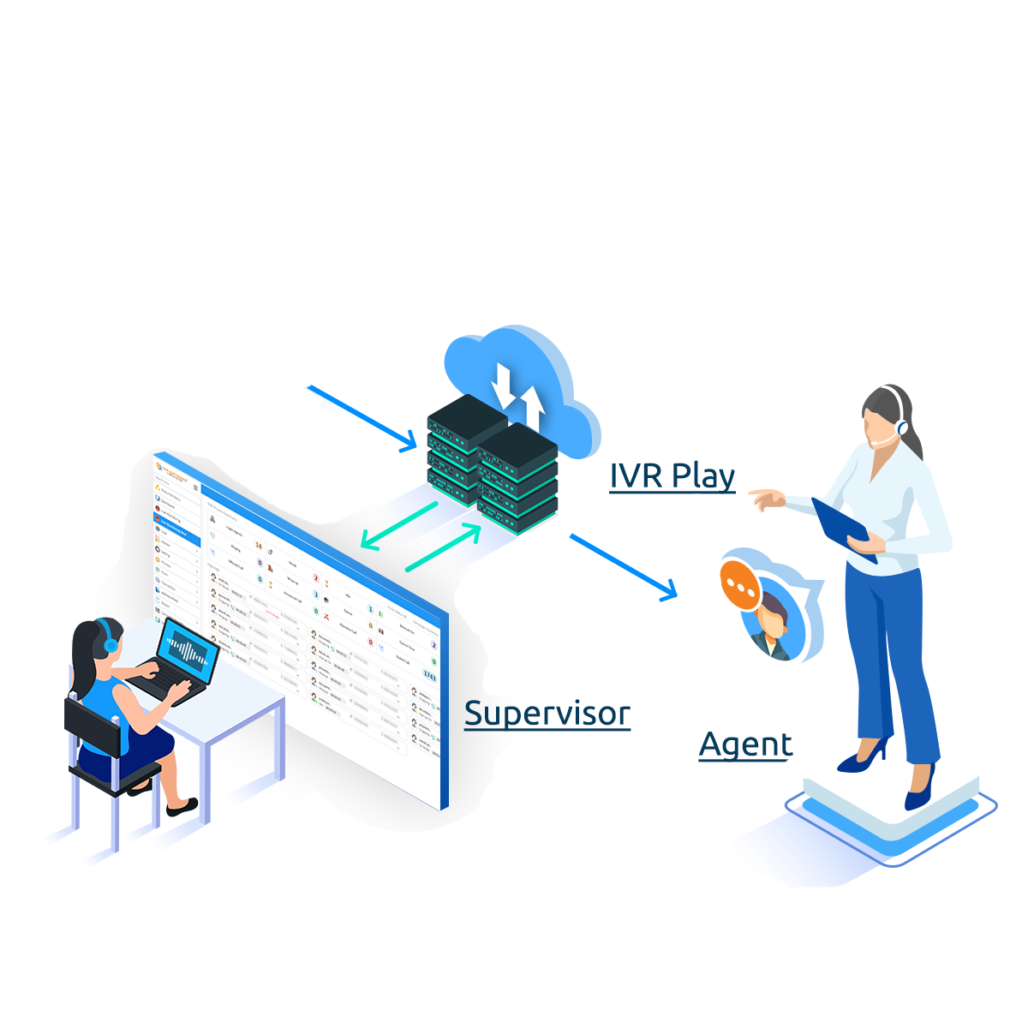
SanCCS Cloud
SanCCS Hosted Solution
Works with Zero Hardware Requirement due to its cloud based dependency it doesn’t need setup of any hardware, it can be deployed instantly with low investment.
Calls on cloud can be attended by agents from their mobile or any other device, its a highly scalable solution with Live Panel, CDR, AMS, SLA, AHT, AQT, ASA and Custom Reports.

Slide 8
Features you get with SanCCS cloud
CRM
SanCCS is a solution that not only works as a dialer but is a fully feature packed CRM that allows our users to maintain a customer database that helps them build a stronger connection with their client.
Single/Dual leg Calling
SanCCS Supports both single leg and dual leg calling, so our users can get a full spectrum of possibilities to use our software in their working environment.
WhatsApp Integration
SanCCS supports WhatsApp business API Integration, so our users can connect to their clients via WhatsApp with SanCCS

Slide 9
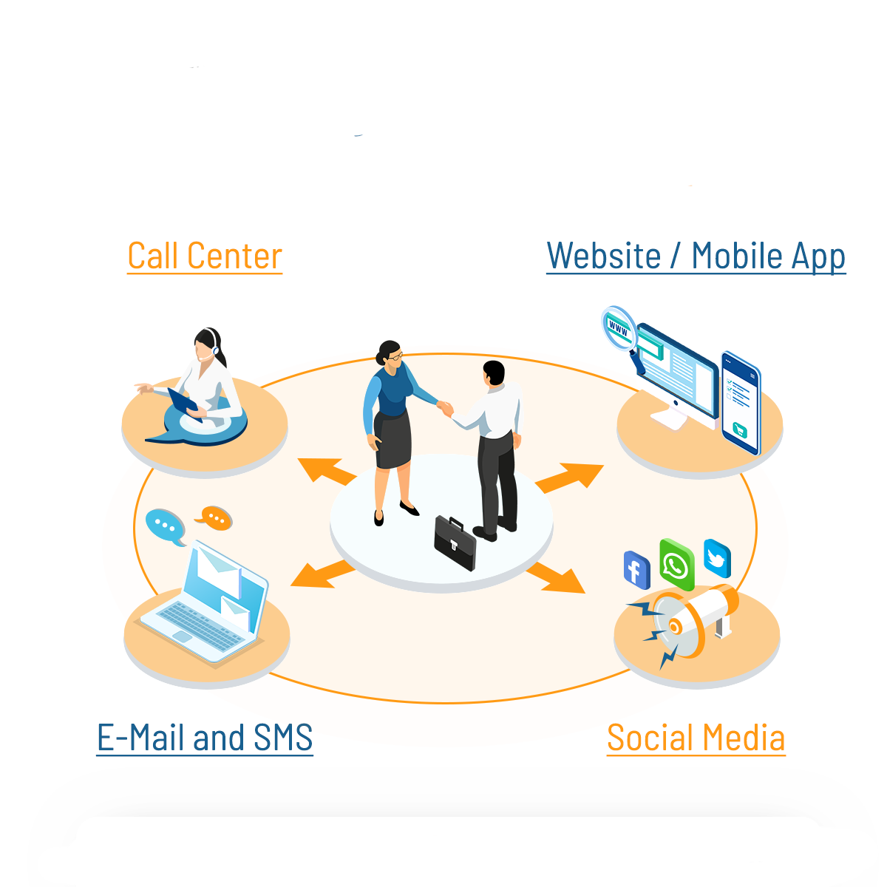
SanCCS on Premises
SanCCS on premises Solution
Just as the cloud solution SanCCS can also be deployed on the customer premises with advance features built in like OMNI channel integration and advance data security it allows our clients to use full strength of our software without ever worrying about their data.

Slide 10
Features you get with SanCCS on Premises
CRM
SanCCS is a solution that not only works as a dialer but is a fully feature packed CRM that allows our users to maintain a customer database that helps them build a stronger connection with their client.
Single/Dual leg Calling
SanCCS Supports both single leg and dual leg calling, so our users can get a full spectrum of possibilities to use our software in their working environment.
OMNI Channel Integration
SanCCS supports OMNI Channel Integration which allows our clients to receive lead data from channels like Facebook, Twitter, Website and WhatsApp on a common platform.

Slide 11
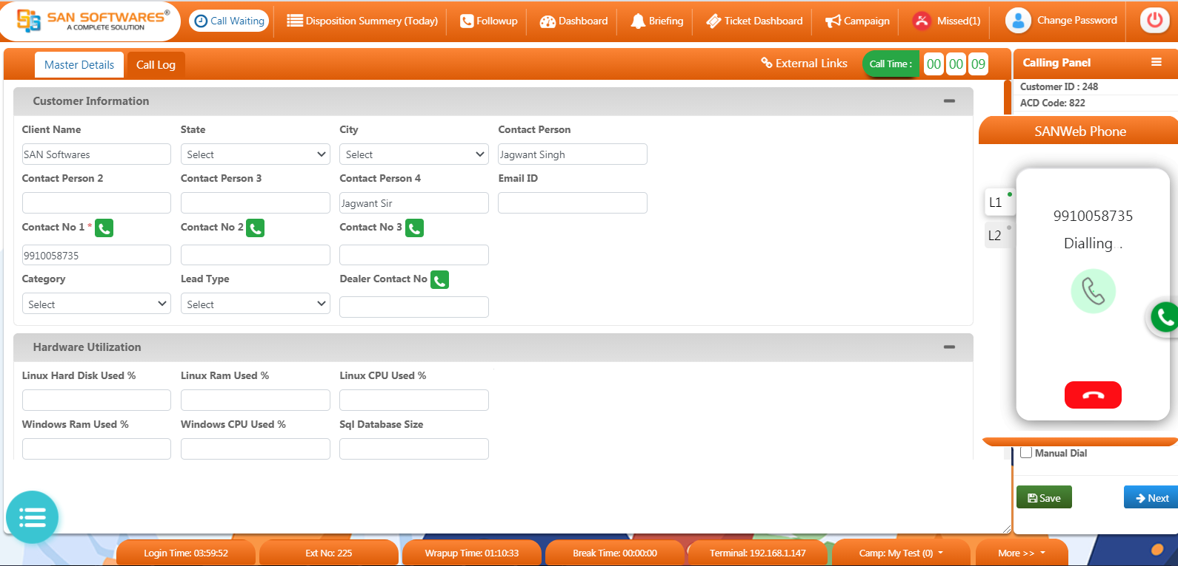
SanCCS Agent Screen with WebPhone

Slide 12
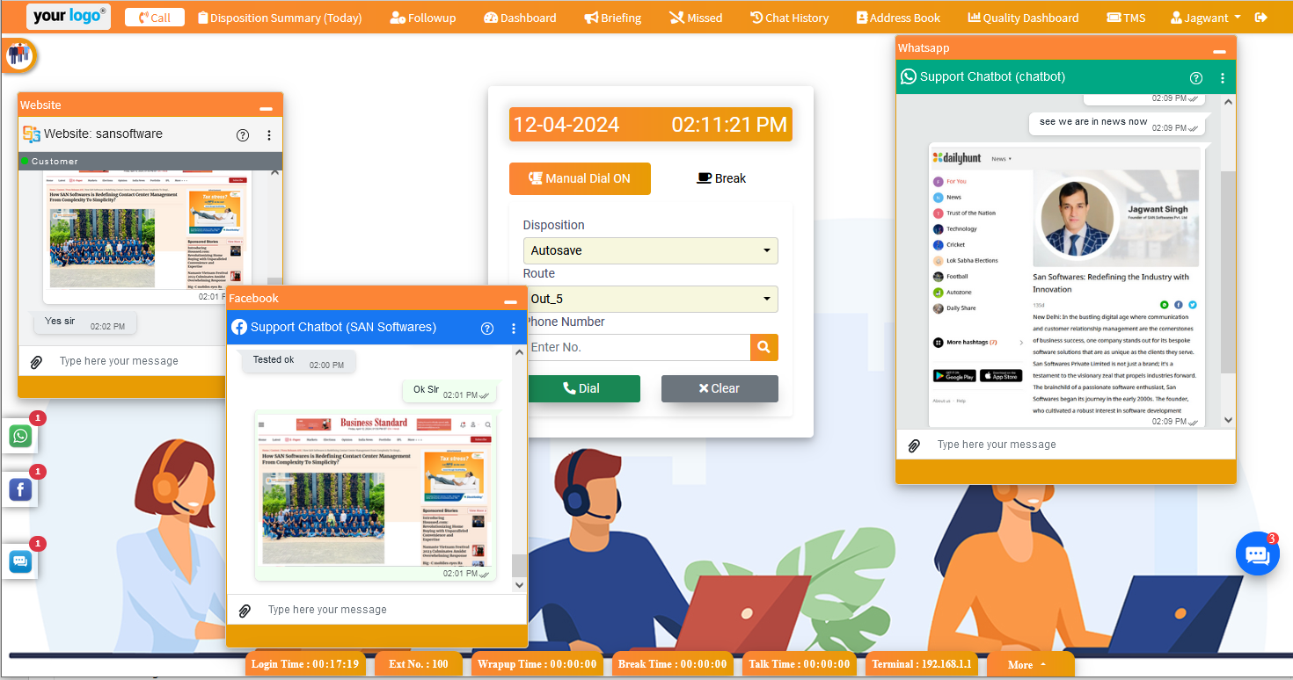
SanCCS Agent Screen with OMNI

Slide 13
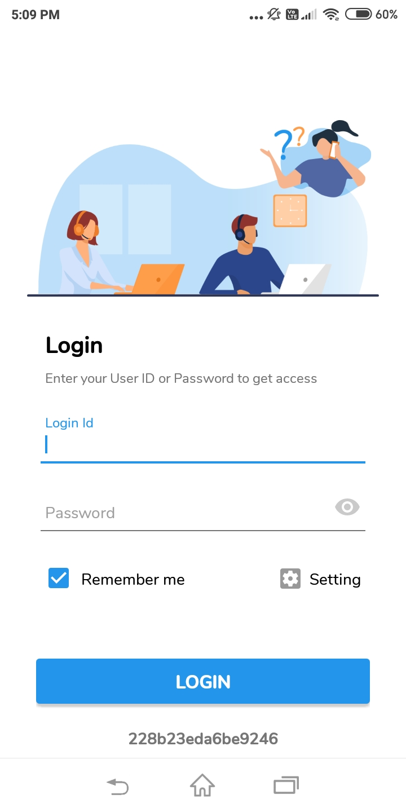
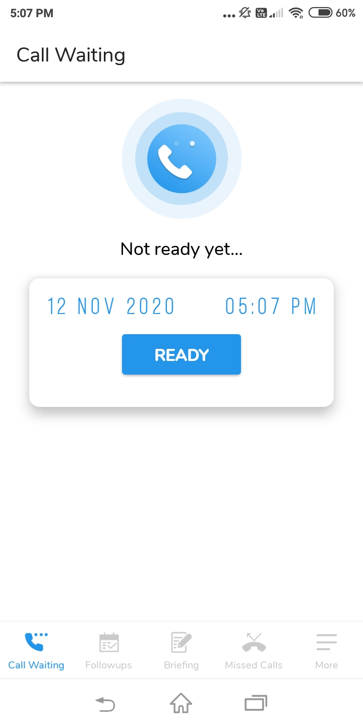
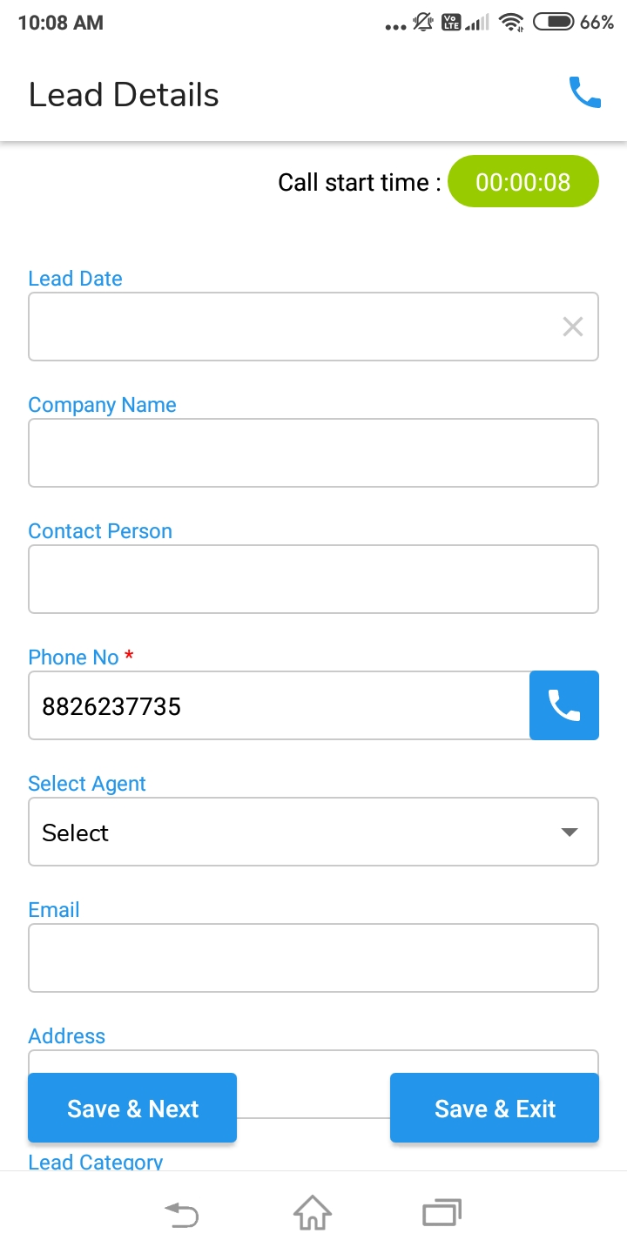
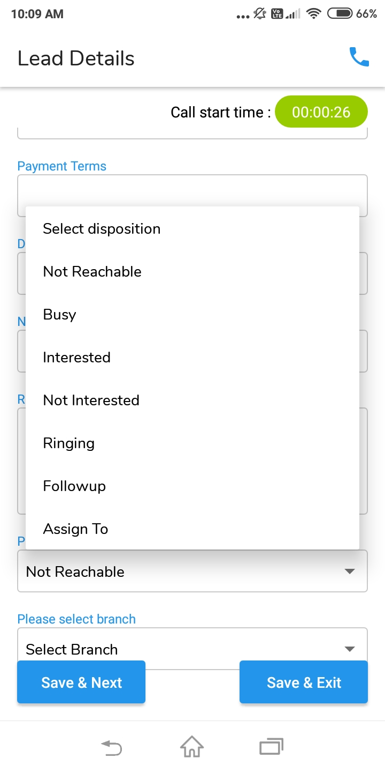
SanCCS Mobile App with OMNI

Slide 14
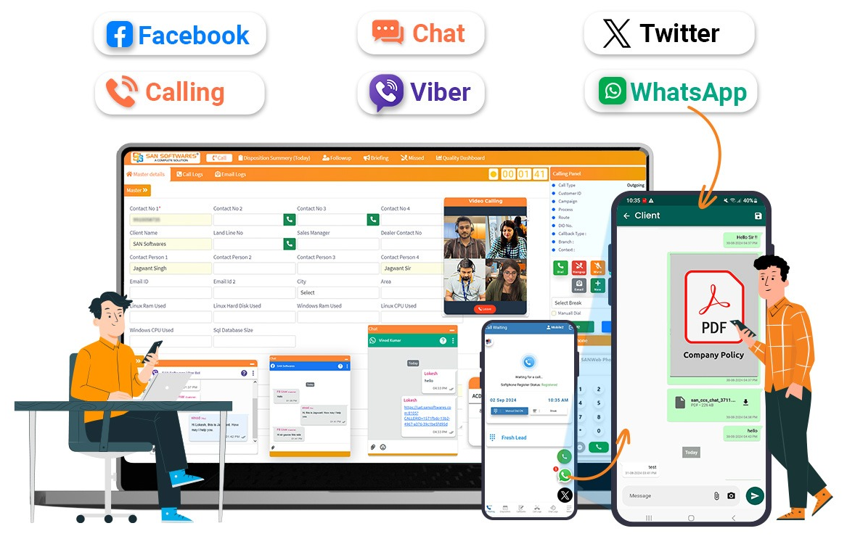
SanCCS Mobile App with OMNI

Slide 15
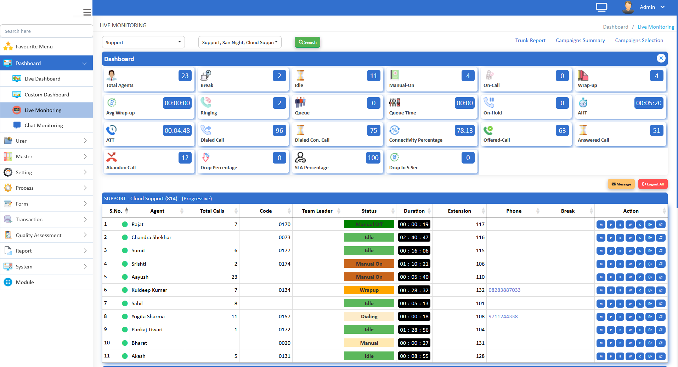
SanCCS Admin Live Monitoring

Slide 16
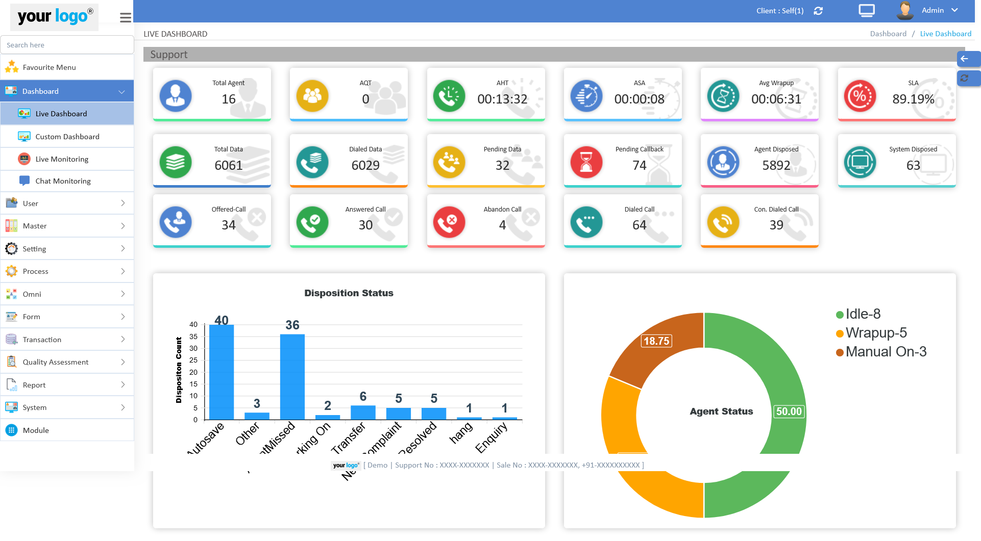
SanCCS Admin Live Dashboard

Slide 17
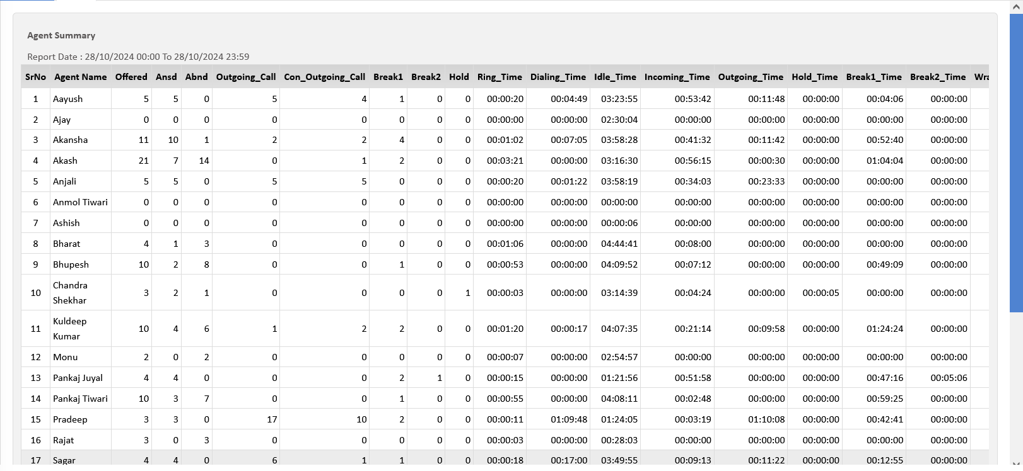
Agent Productivity Report (APR)

Slide 18
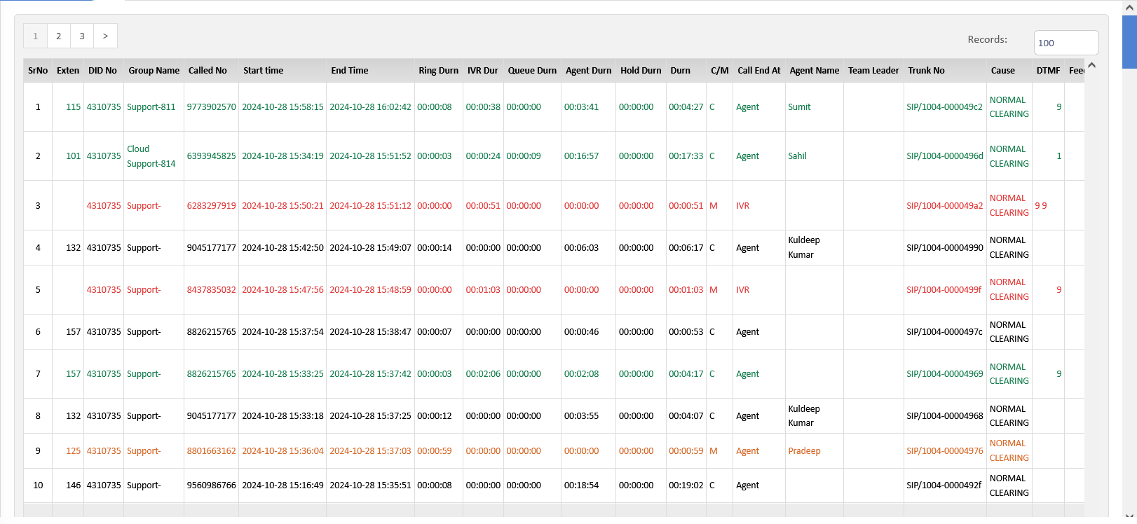
Call Detail Report

Slide 19
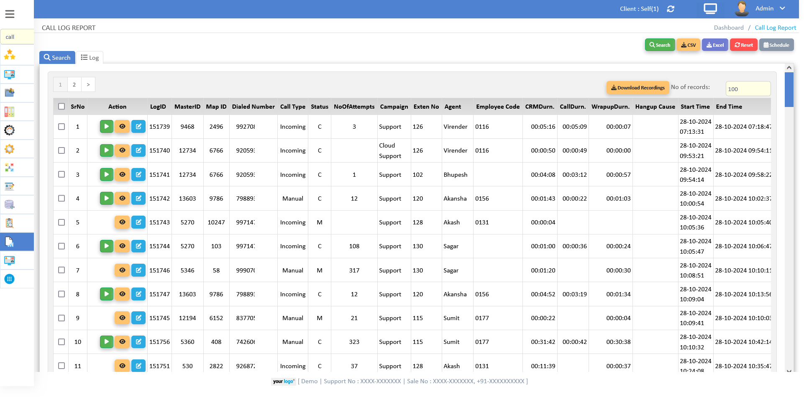
Call Log Report

Slide 20
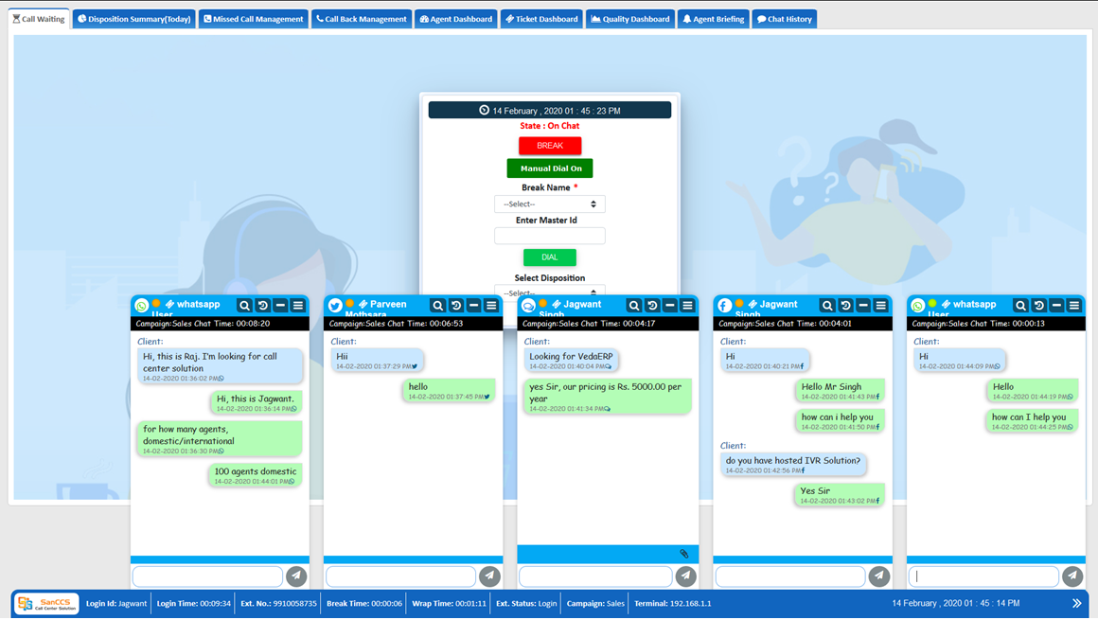
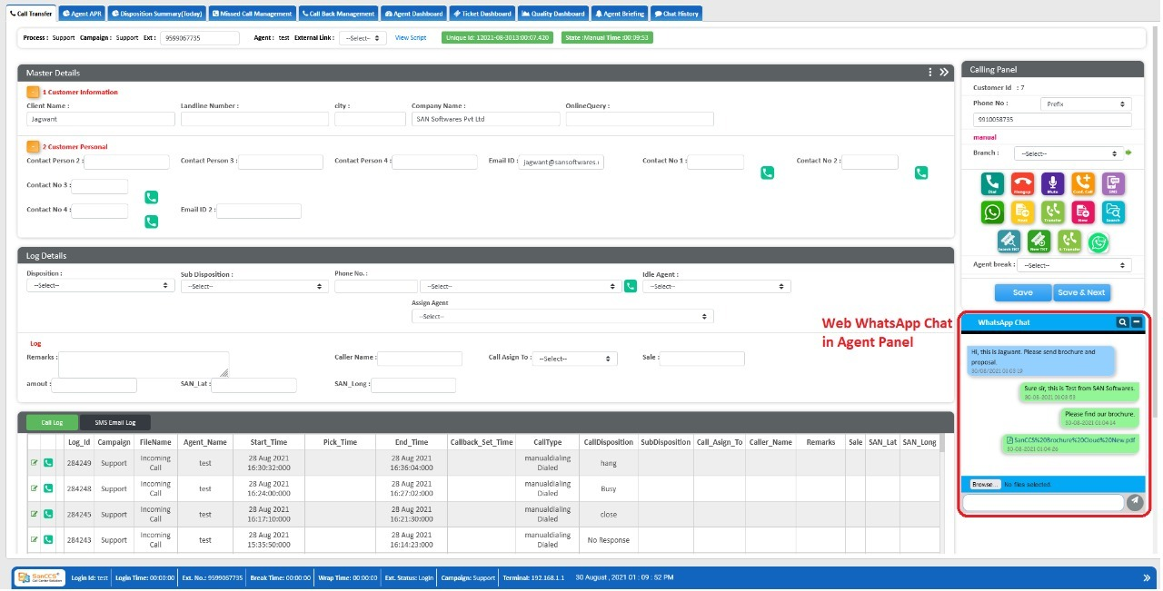
SanCCS with OMNI Channel

Slide 21
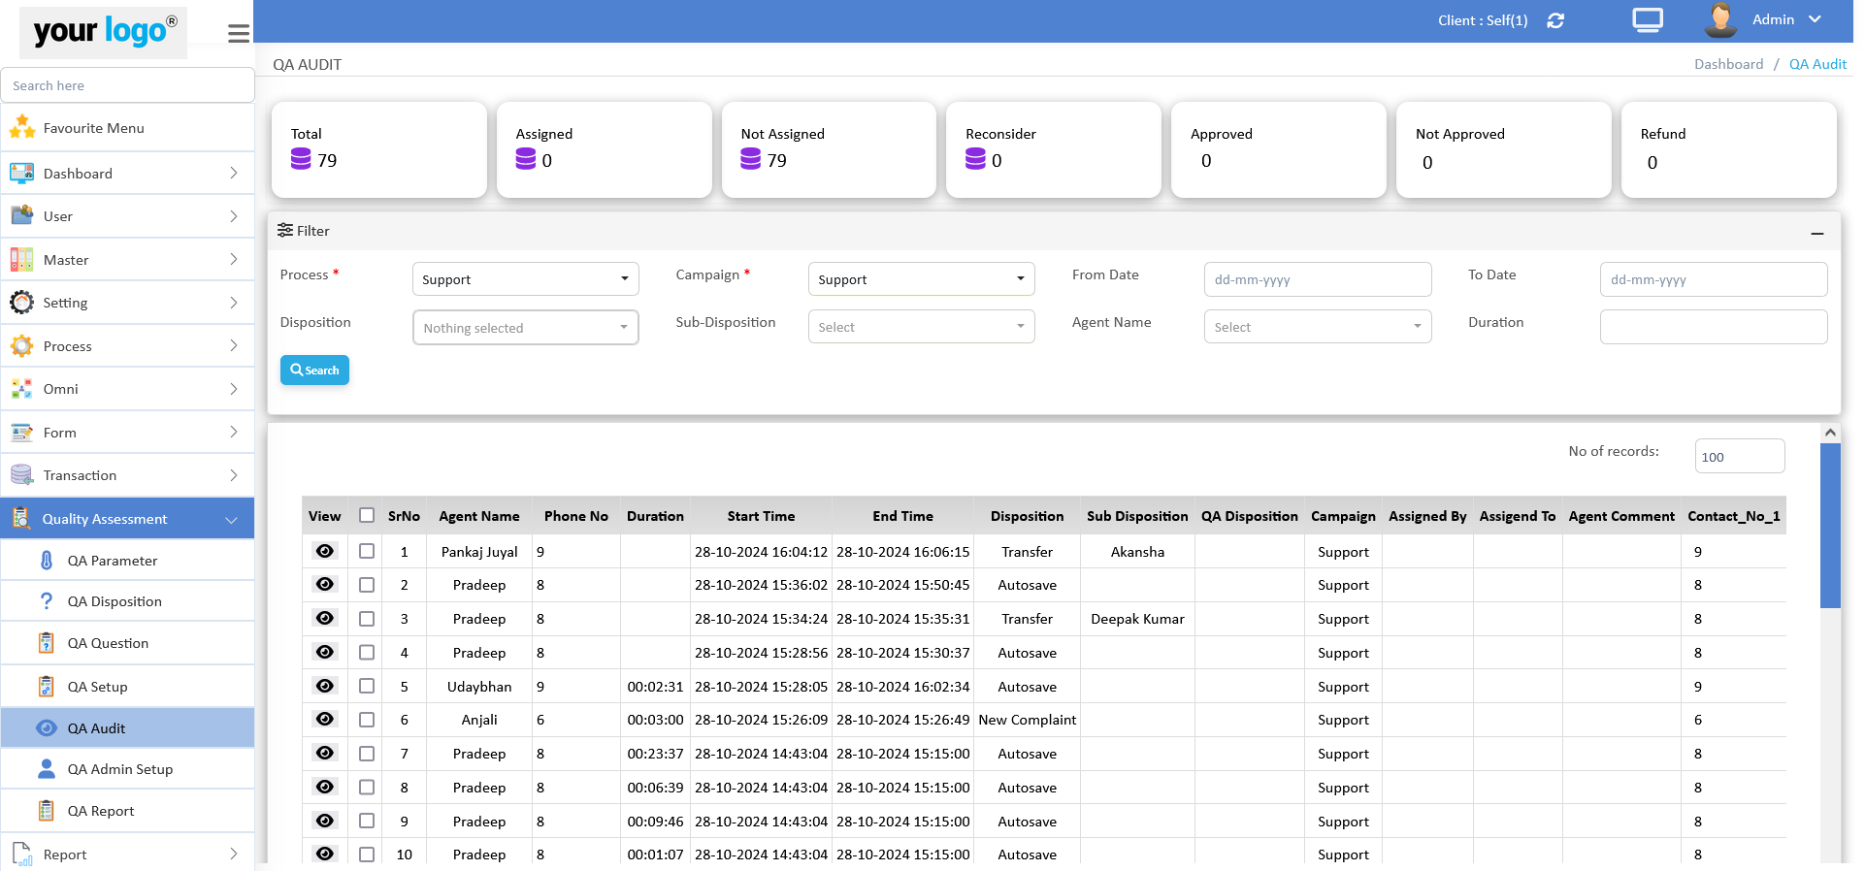
Quality Auditing Tool

Slide 22
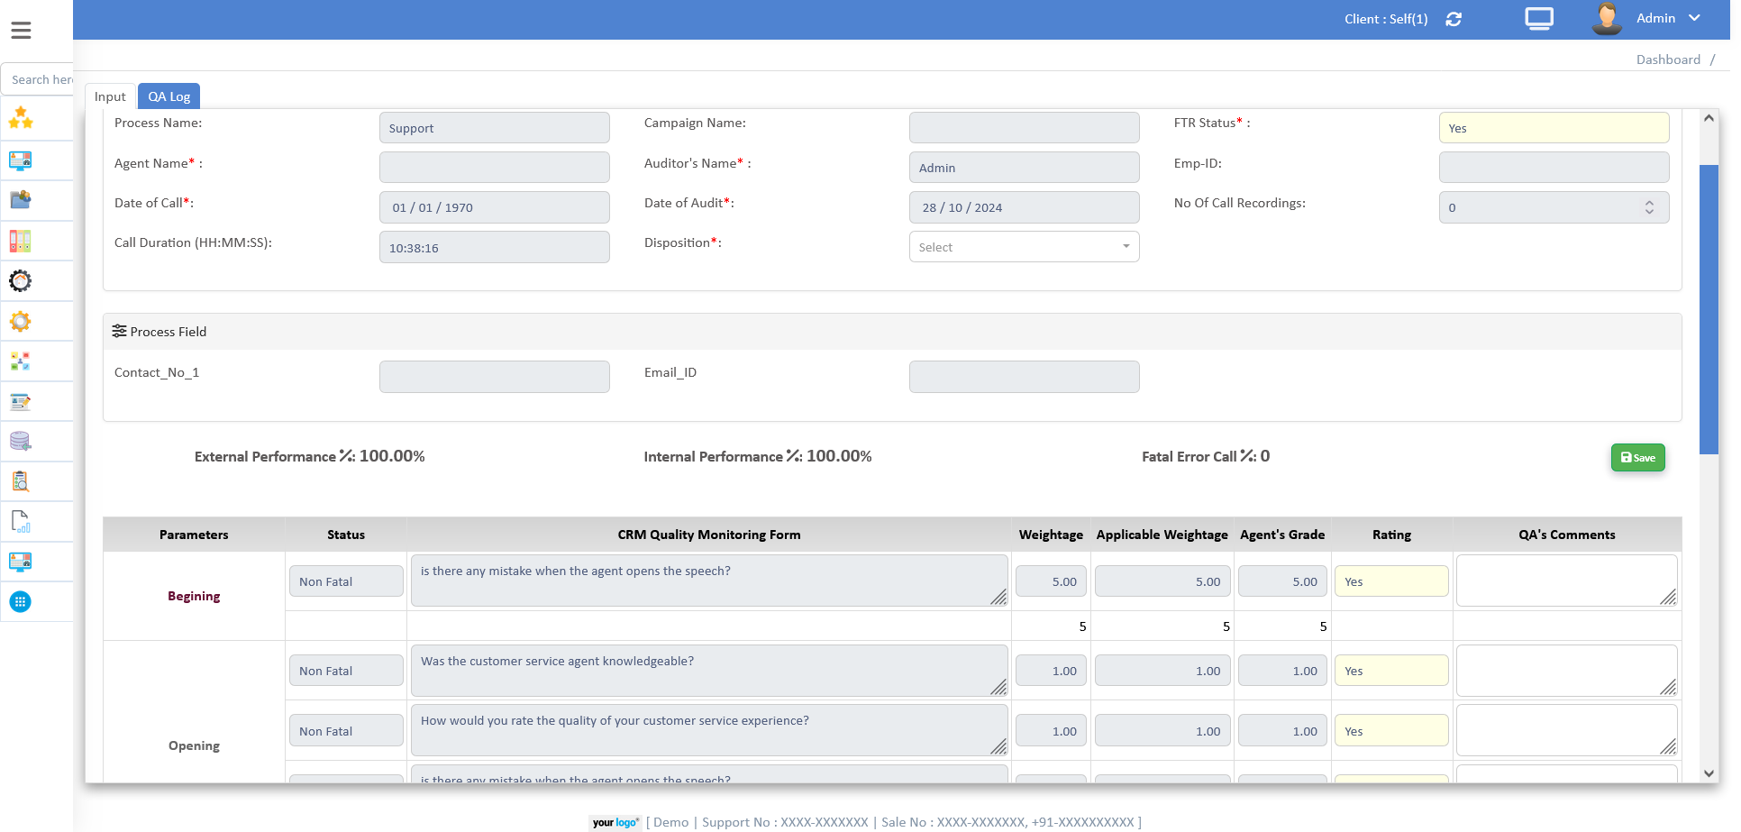
Quality Auditing

Slide 23
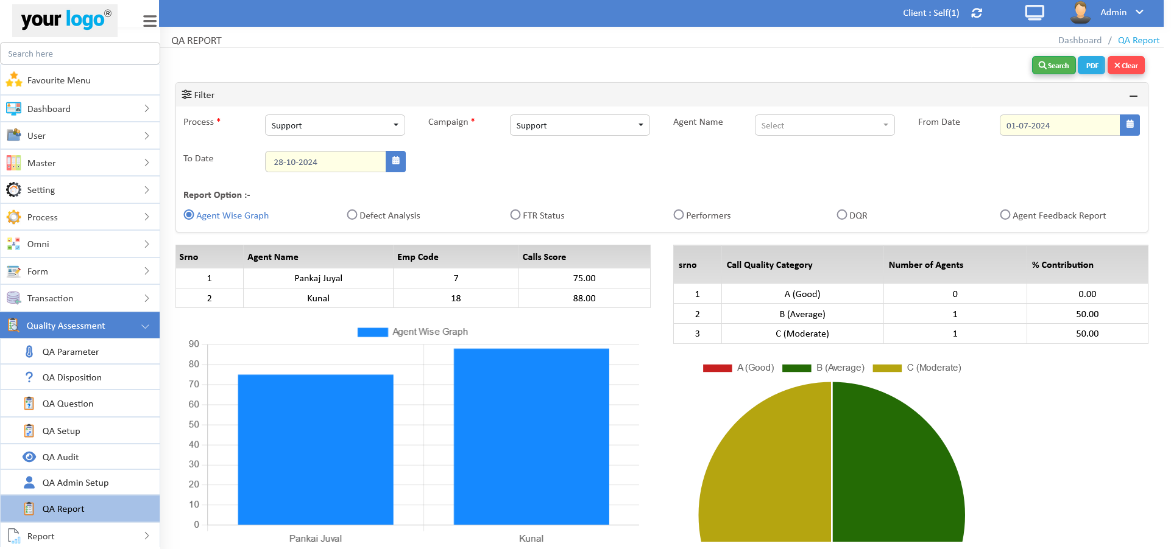
Quality Auditing Dashboard

Slide 24
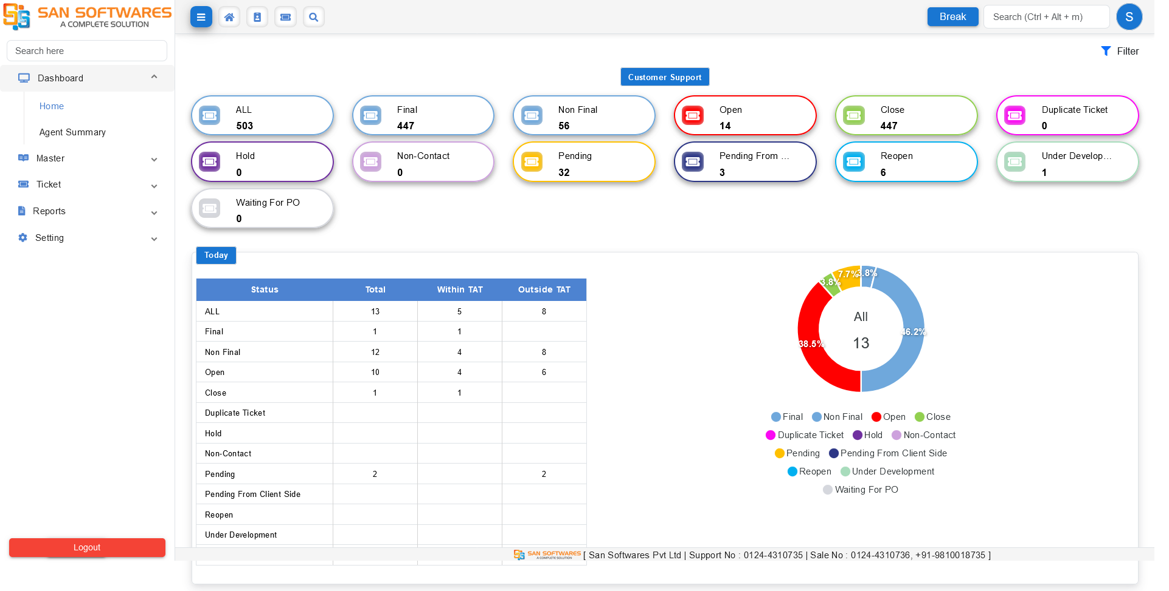
Ticket Management Dashboard

Slide 25
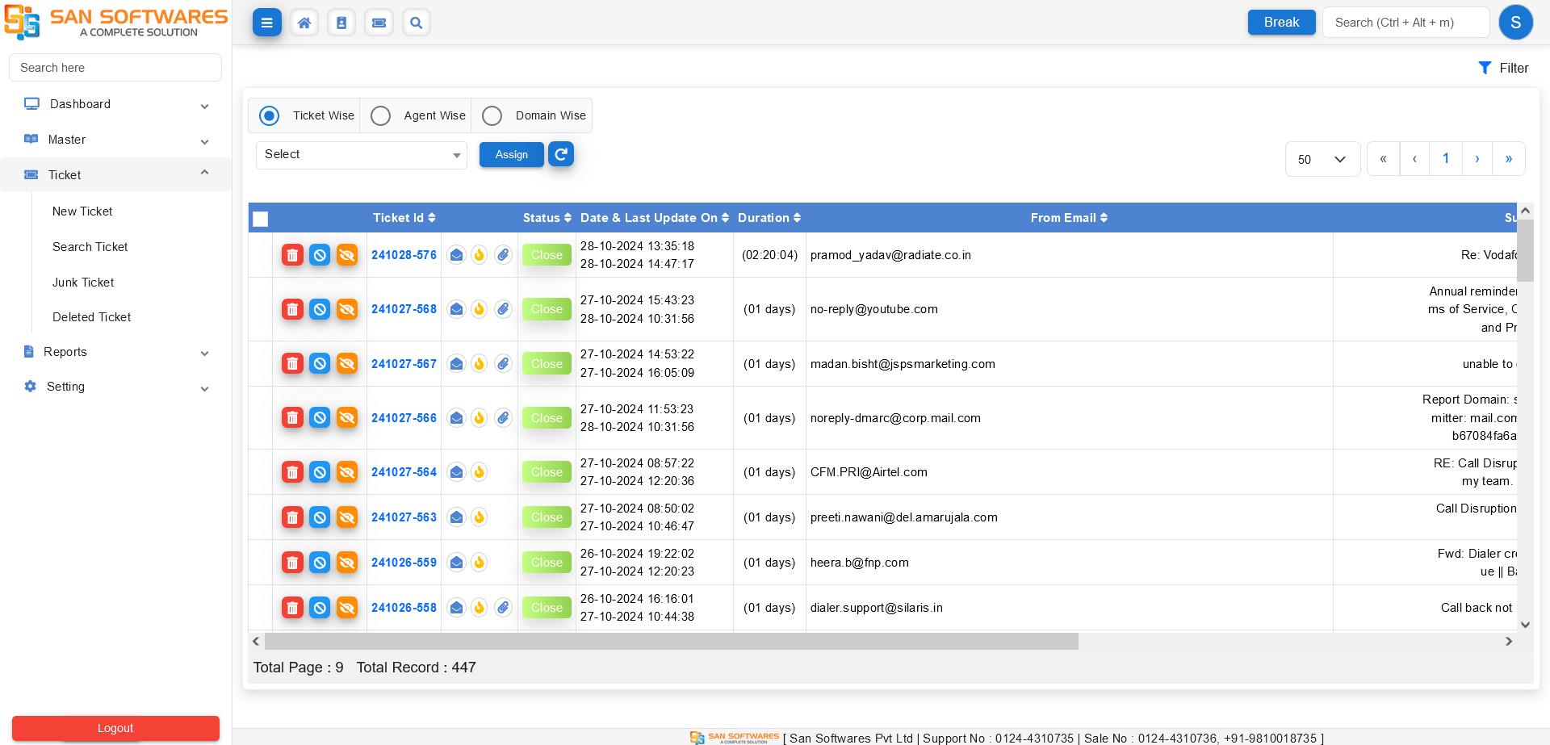
Ticket Management List

Slide 26
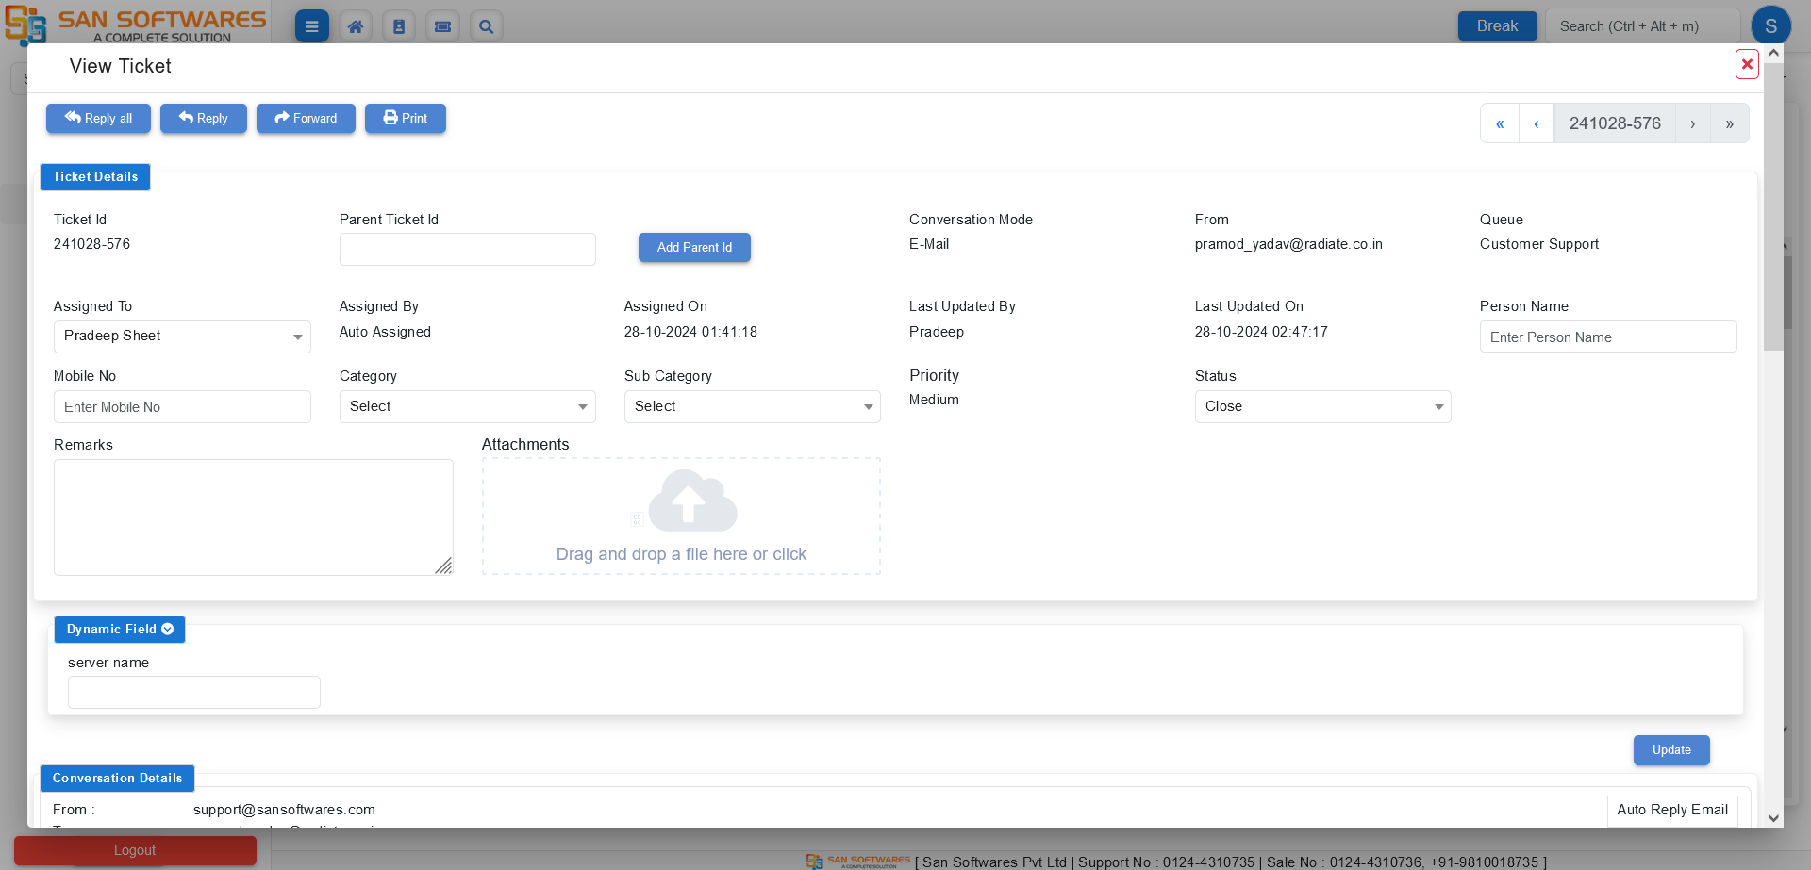
Ticket Creation

Slide 27
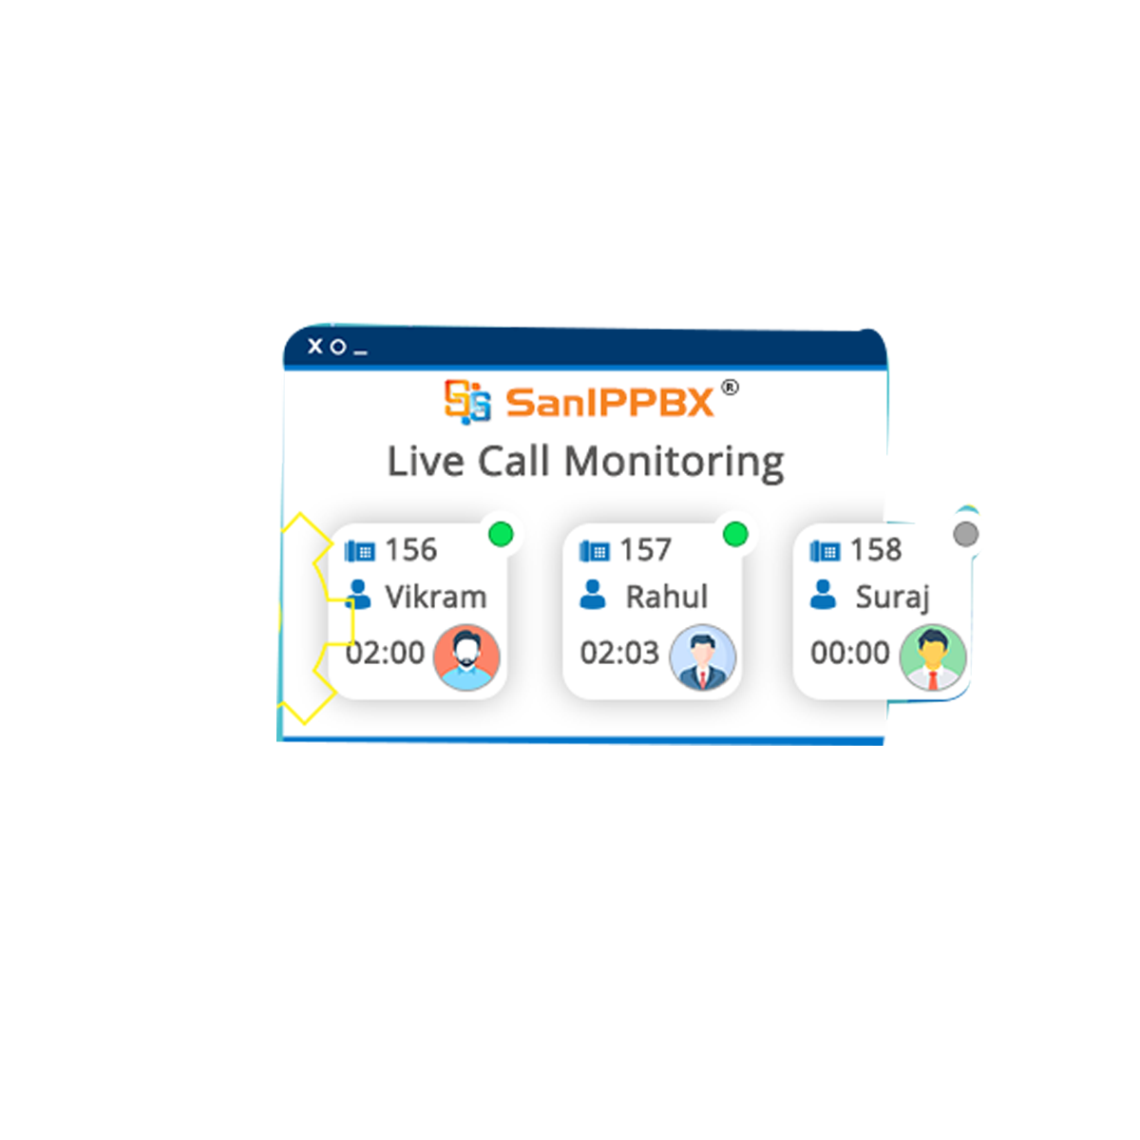
SanIPPBX
The best in class IP PBX for In-House Set Up that supports up to 2000 extensions or 10 call centre agents with CRM with recording and up to 200 concurrent calls without recording.

Slide 28
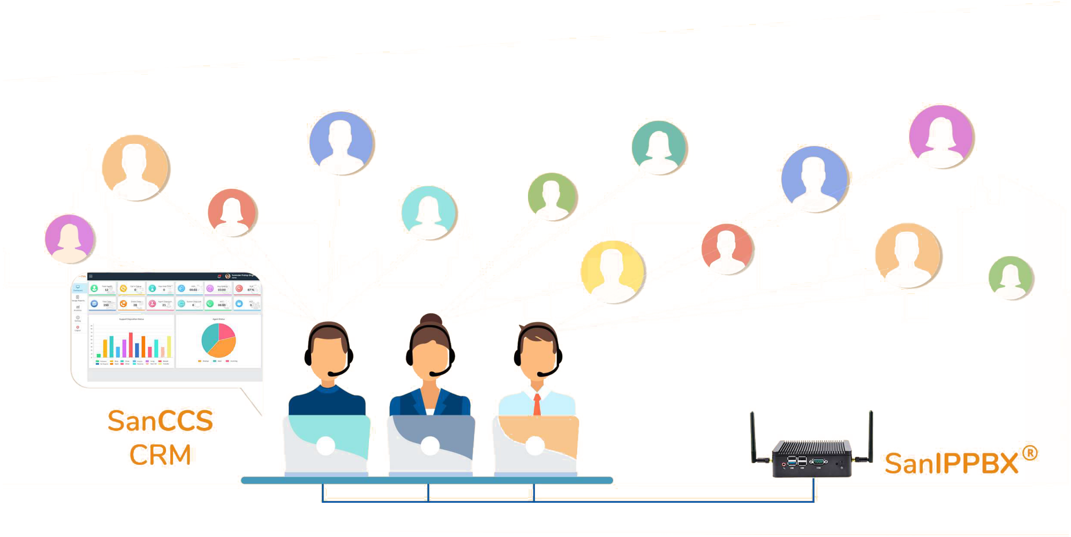
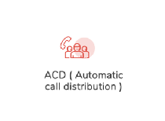
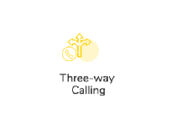
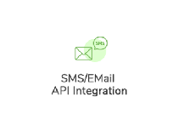
SanIPPBX Features
Highlights
CRM Integration

Slide 29
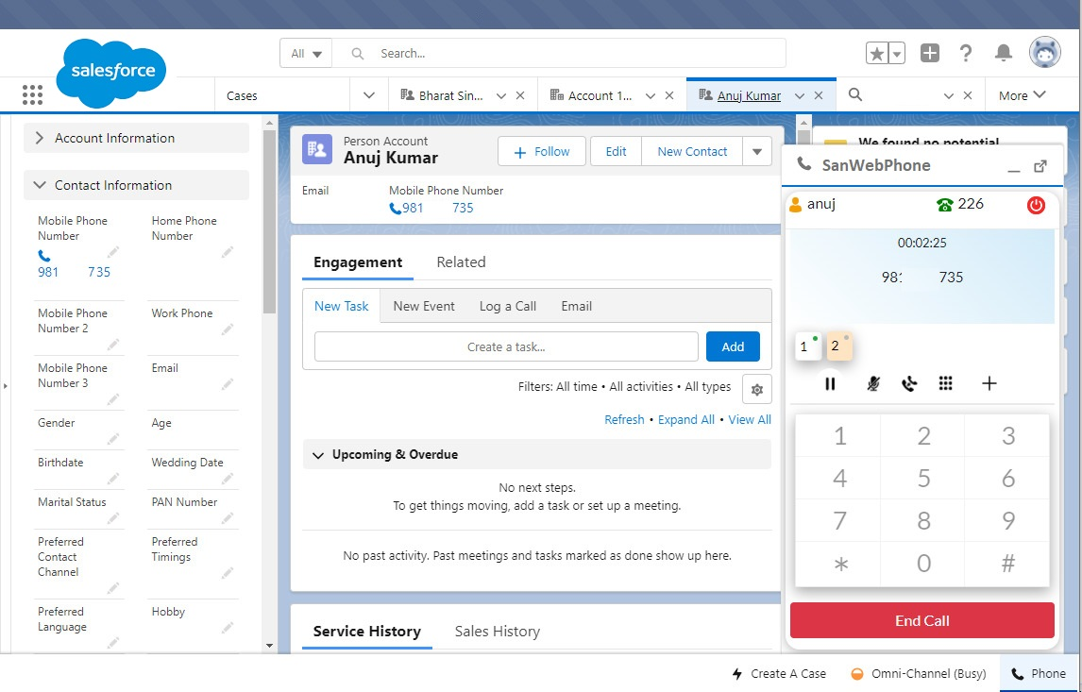
SAN Integration with

Slide 30
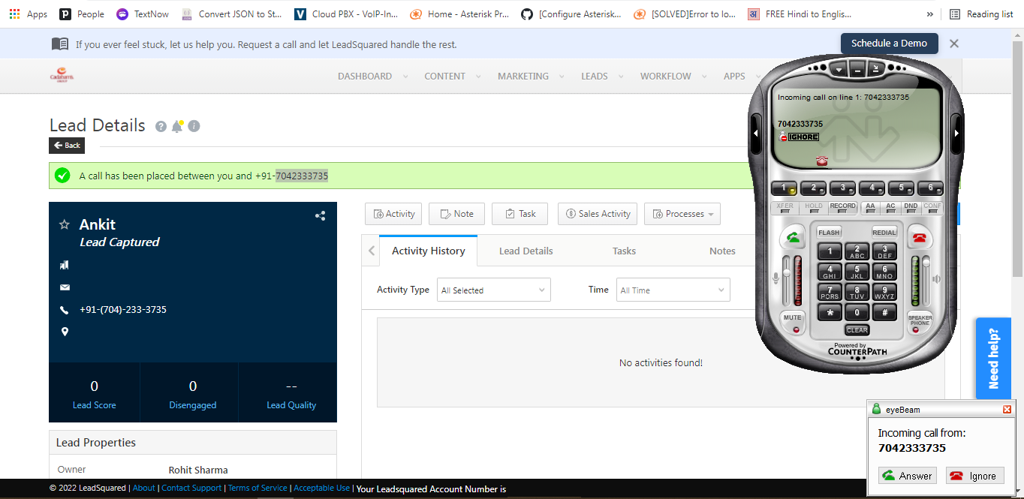
SAN Integration with

Slide 31
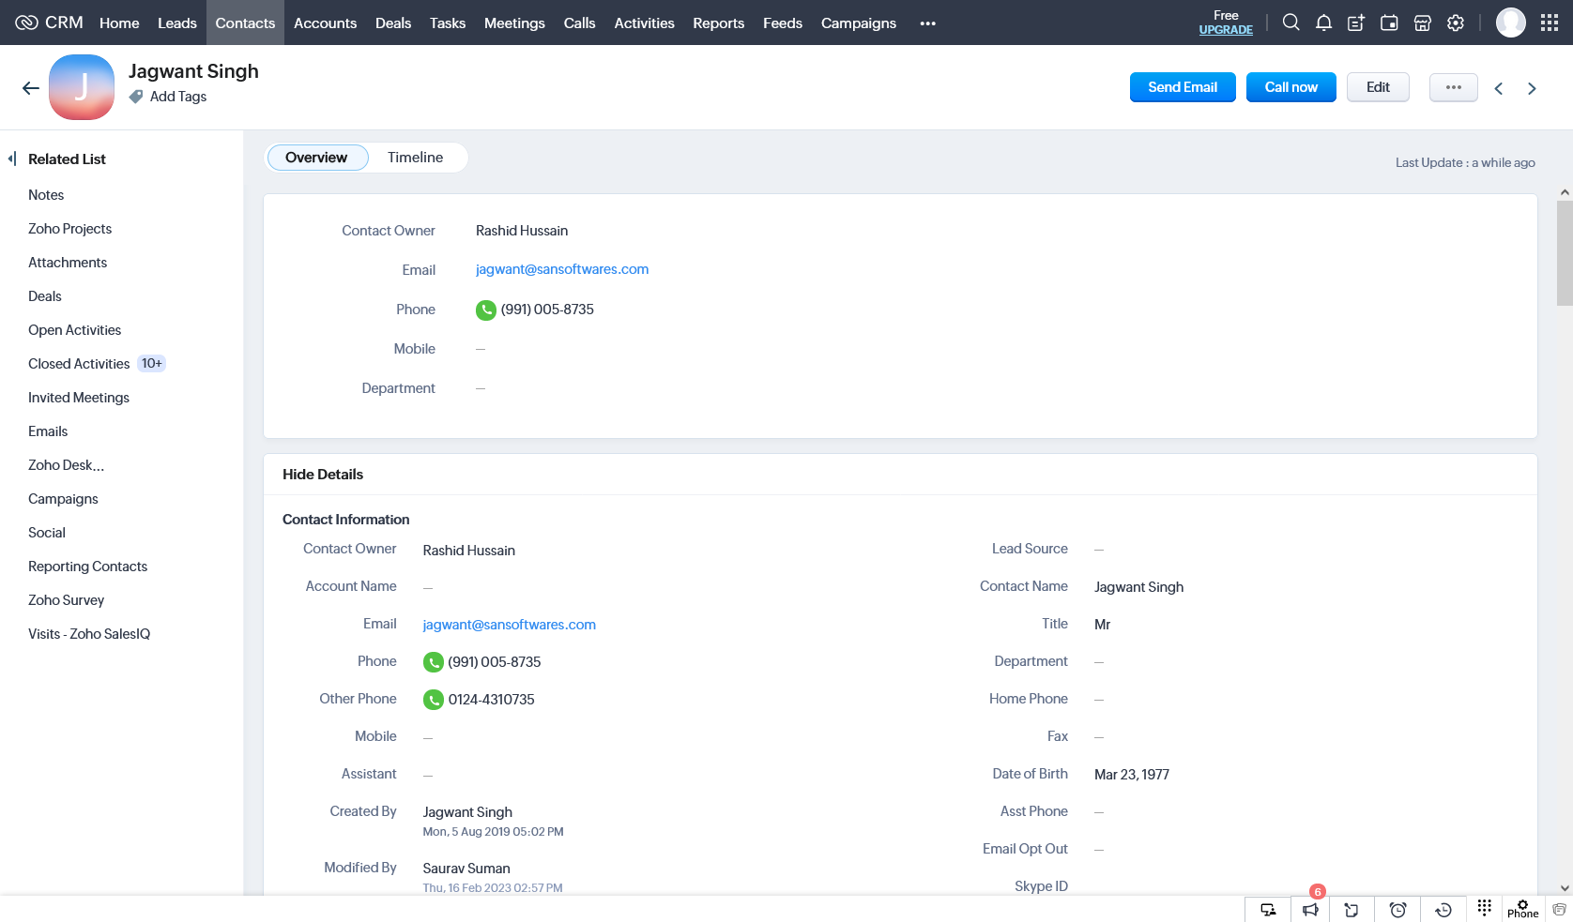
SAN Integration with

Slide 32
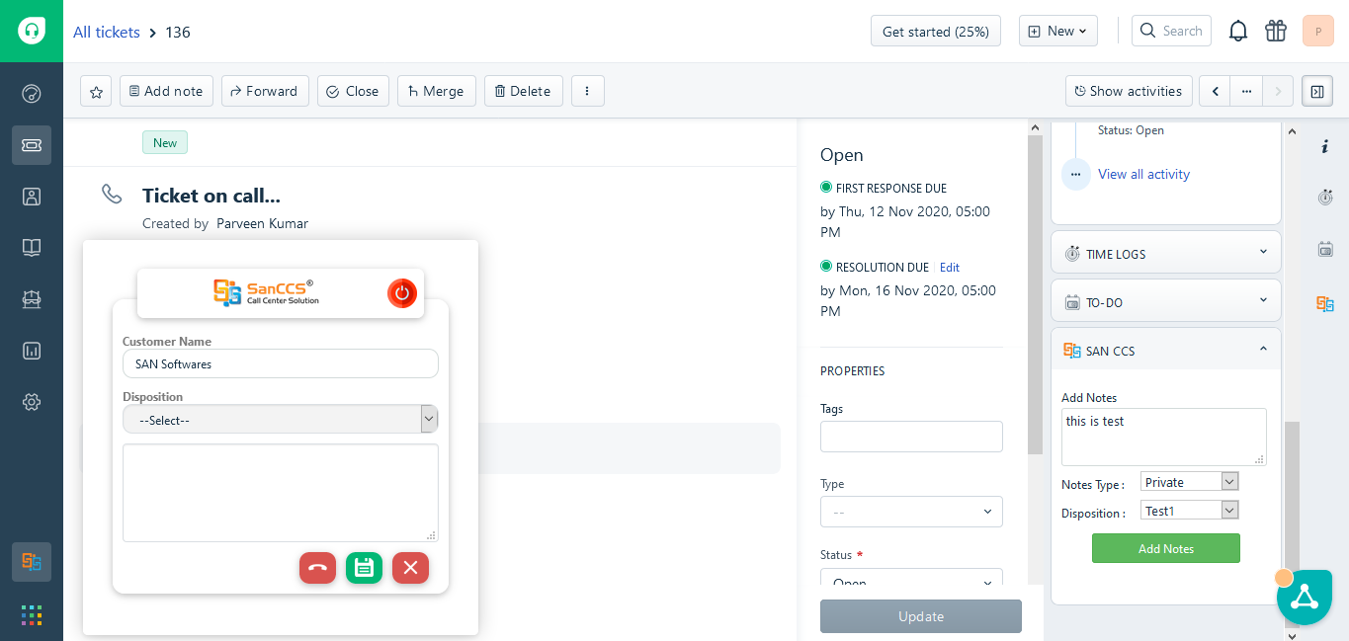
SAN Integration with

Slide 33
EasyGoIVR
Hosted IVR Solution
EasyGoIVR is a cloud based service which gives you an easy access for real time call reporting and monitoring of incoming and outgoing calls over a period along with graphical representation of number of total calls connected and answered, hence decreasing your hardware cost and boost your business with best IVR Solution.
IVR Play
Application
(server 1)
Agent
Data Base
(server 2)
Cloud
Team Lead
Dial

Slide 34
VedaERP
One Stop Solution for your ERP Requirements
VedaERP software is the all-in-one, comprehensive software, designed to run your business successfully. It maximizes your time, improves staff efficiency, improves CRM, Accounting, Inventory, LMS, CTI Integration, Sales Portal Integration and helps your organisation to convert more leads into business. VedaERP is an innovative and cost effective end to end management solution that delivers core business value to companies.

Slide 35
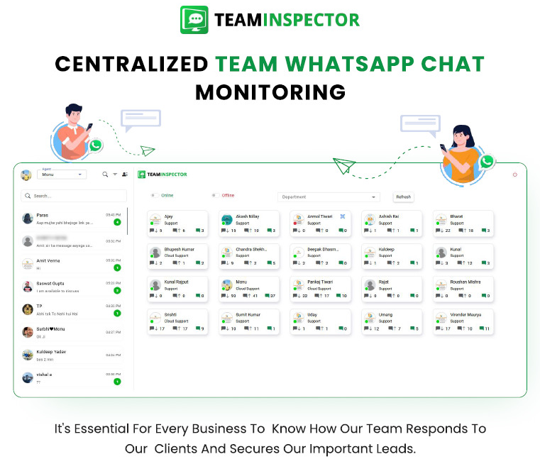
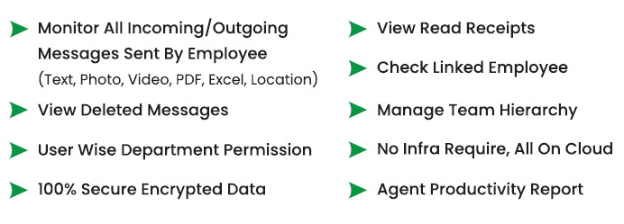
TeamInspector and Features

Slide 36
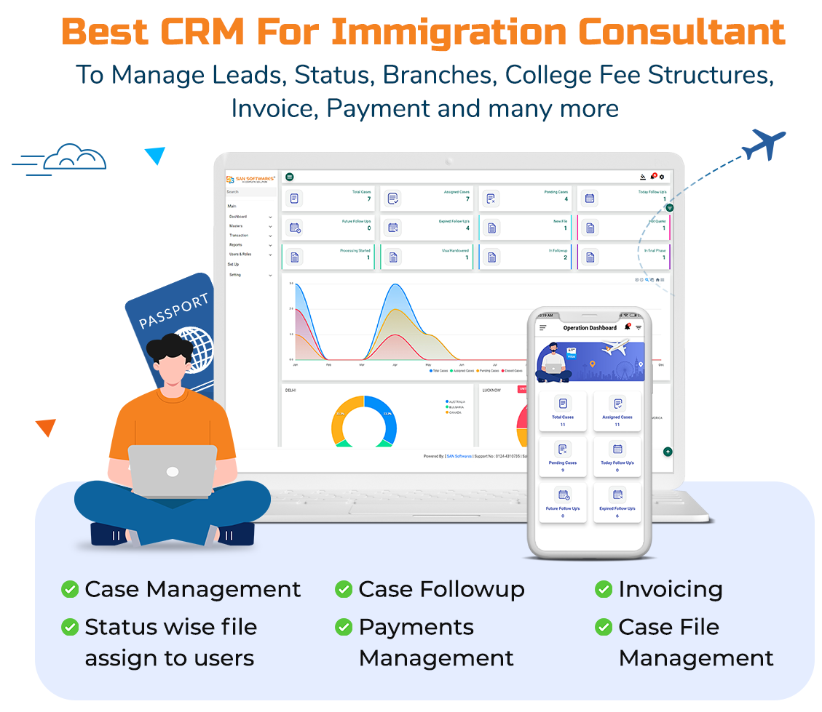
SanE-Visa and Features

Slide 37
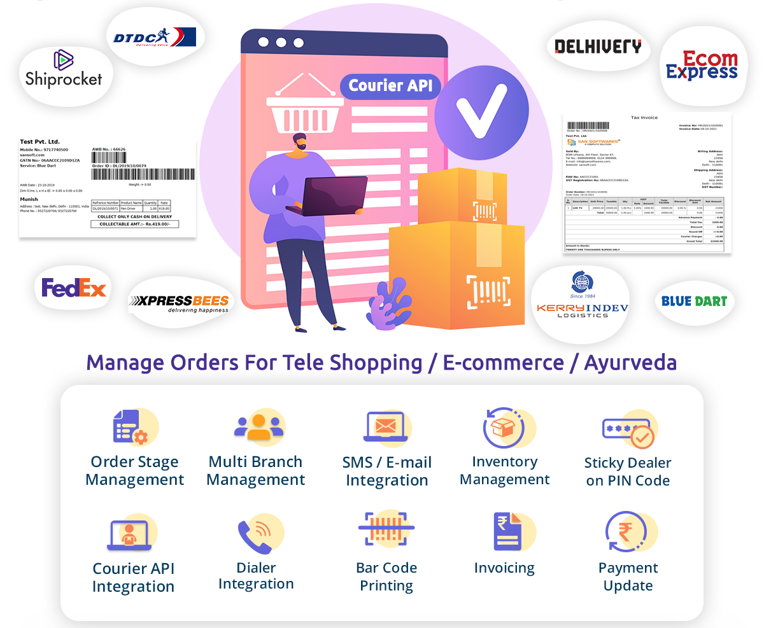
SanORDO and Features

Slide 38
We Work In Harmony
SanCCS and SanIPPBX
3rd Party Applications API
Comfortable Working Enviorment for our Clients
SanCCS and SanIPPBX is customizable for our clients
3rd party Applications like: ZOHO, Salesforce, Freshdesk, lead square and Pipedrive Etc.
With 3rd party application integration we can provide a comfortable Woking environment for our clients , so they can use the setups they are most used too.

Slide 39
Industries We Have Served
Health Industry
BPO/E-Commerce
Auto Industry
Real Estate
Education System
Road side assistance
Insurance Industry
Ticketing

Slide 40
Industries We Have Served
Health Industry
Usage of call center solution in Healthcare Industry.
Managing patient engagement plays an increasingly critical role in the ability of healthcare providers to keep up with the growing demand for quality services and expectations of the patient or attendant. An aging population requiring greater levels of care combined with rapid changes in technology which is now making it imperative for the healthcare service providers to research ways of exceeding customer expectations and at the same time managing the costs to an acceptable level.

Slide 41
Industries We Have Served
Health Industry
Problems in the Health Sector:
Difficulty in handling large number of incoming calls
Manpower requirement at call center to handle so many calls
Managing past medical records of the patients
Quickly finding the call history of the patient

Slide 42
Industries We Have Served
Health Industry
Solution
The biggest challenge for any software or call centre solution company in designing software for a hospital is the difference in size. At San Software we overcame this problem by developing a platform that can be customized based on the requirement of the healthcare service provider.

Slide 43
Industries We Have Served
Auto Industry
Usage of call centre solutions Automobile
With the increase in purchasing power capacity of the people in the country, Automobile companies are leaving no stone unturned to woo the customer in buying their brand. With most of the companies having their variants in all car segments, it is becoming difficult for businesses to retain their customers. It is very clear that just making the customer buy a car does not end the job, keeping the client is an even tougher job and has to be persisted with each and every day. If not, it is very easy to lose the customer.

Slide 44
Industries We Have Served
Auto Industry
Problems in the automobile sector:
Losing customers because of increasing competition
Salespersons are busy in scouting for new database rather than making sales
pitch
Following up with the existing customers
Staying in touch because of lack of customer history

Slide 45
Industries We Have Served
Auto Industry
Solution
The most important thing while designing a call centre solution for an automobile player is to provide the solution to retain the client for as long as five years or even more in some cases. This medium achieved if the company starts treating customer as one big family and keeping a record of all their needs. At San Software we overcame this problem by designing a platform that can be customized based on the requirement of the company at the same time not compromising on the looking after the needs that can guide business growth.

Slide 46
Industries We Have Served
Insurance Industry
Usage of call center solution in Insurance Industry
Insurance providers must serve the needs of two distinct customer audiences: Policyholders, and agents/brokers. In todays environment, ease of doing business and 24/7 access to personalized services are among the most important factors influencing which provides an agent, or Policyholder will select. Customers frequently change providers because of poor customer service or the inability to resolve issues efficiently. Additionally, customers rarely interact with their insurance provider, making it even harder to foster customer loyalty.

Slide 47
Industries We Have Served
Insurance Industry
Problems in the insurance sector:
Fierce competition with so many new players in the market
Getting new customers
Handling queries efficiently
Effective claim settlement and status reporting

Slide 48
Industries We Have Served
Insurance Industry
Solution
After analyzing the requirements of the insurance sector in India, San Software has developed a customized solution for insurance companies in India to streamline the process and augment the customer base for higher profits. San Software offers innovative and customized call centre solution for insurance companies. Our solutions are adaptable and provide ease of usage to the end user.

Slide 49
Industries We Have Served
Education System
Usage of Call Center Solution Education
Education industry in India is one of the most profitable. When we talk about education, we mean all education is imparting institutes that include schools, colleges, universities and professional coaching centers. The demand for admission in these centers is the large but efficient handling of the leads and queries is the key to success and increase in the bottom lines.

Slide 50
Industries We Have Served
Education System
Problems in education industry:
Growing competition leading to multiple options for students
So many courses on offer, maintaining a well compiled detailed database
Training to answer course specific question or to create domain champions
Routing calls to the right person for perfect solution to the prospective student
Deciding upon allocation of resources in real area for better ROI
With improved broadband and smartphone usage, a significant number of queries are generated but are not attended.

Slide 51
Industries We Have Served
Education System
Solution
The majority of students seeking admission start their college search online. The number of options at their disposal, it becomes necessary for the colleges to have a high conversion ratio and ideally in the first call itself. Most leads from prospective students received through ads, Internet promotion & SMS. To ensure that these leads are not missed & are followed up proactively by the team there is a need for a dynamic Call Center Solution for multi-channel (Voice / Email / SMS & Chat) contact with such students. SanCCS is our Call Center Solution that is the customized solution for any sector requiring call center or Dialer Services. At San Software we also assist you with tracking these communications in an activity log that shows all Phone calls received/made, Emails received/sent, SMS received/sent & more.

Slide 52
Industries We Have Served
Real Estate
Usage of call center solution in Real Estate
Real Estate is one sector that has grown by leaps and bounds. With real estate developers deciding to foray into peripheries and Tier B cities, the demand is expected to increase further and so will be the profits. Demand for commercial and residential property driven by urbanization & increasing household income. The Emergence of nuclear families and growing urbanization has given rise to several townships. With some of the commercial & housing infrastructure projects is being launched, The choice of the people has increased giving rise to stiff competition. But the fact of the matter is that these all can just disappear if the leads are not well attended.

Slide 53
Industries We Have Served
Real Estate
Problems in Real Estate Sector:
Providing solutions that can suit to the particular strata of the society
Comprehending the features of the project and explaining to the customer in the
best possible manner
Knowledge of the loans and requirements
Low conversion rate

Slide 54
Industries We Have Served
Real Estate
Solution
The best way forward for the real estate companies is to adopt the best lead generation techniques & ensure that all points are captured correctly into the system and followed up diligently for high conversion ratio. As the real estate industry searches for ways to cut costs and improve their bottom line, our call center solution may be the solution your business.

Slide 55
Industries We Have Served
Ticketing
Usage of Call Center Solution in Ticketing
In India internet usage and smartphone users have grown many folds in the past decade or so resulted in extreme pressure on the companies to provide 24 x 7 services. Out of all the maximum pressure is to the companies involved in the booking of tickets like cinemas, amusement parks, etc.

Slide 56
Industries We Have Served
Ticketing
Solution
Booking assistance required 24 x 7
Large non-collated data
Massive manpower needed to cater to the demand
Easy access to customer for customized booking, show reservation or seat selection on real time basis
At San Software we have developed the science of simplicity. We provide simplified solutions directed towards usage for the client and maximum customer satisfaction.

Slide 57
Our Global Footprints
Belgium
Portugal
USA
UAE
Nepal
our office
Australia
South Africa
New Zealand

Slide 58
11,700+
More than 11700 Call Center Agents are using our solution across the globe.

Slide 59
Some of our Health Industry Clients

Slide 60
Some of our Auto Industry Clients

Slide 61
Some of our Education Sector Clients

Slide 62
Some of Our Other prestigious Clients

Slide 63
Some of our Govt Sector Clients

Slide 64
1500+ clients
100%
Our Business Network
Total success!

Slide 65
Our Business Growth Since Our Inception – in value of Rs.

Slide 66
THANKS!
Any questions?
You can find me at:
sales@sansoftwares.com
+91-124-4310-736
+91-9999-121-735

